Slide 1
Speech Processing
A Discrete-Time Signal Processing Framework
Notes:
Digital Systems: Hardware Organization and Design
Architecture of a Respresentative 32 Bit Processor

Slide 2
Introduction
Review of the foundation of discrete-time signal processing:
  Investigation of essential discrete-time methods
  Briefly touch upon the limitations of these techniques in the context of speech processing:
    Time-frequency uncertainty principle, and
    Theory of time-varying linear systems
Veton Këpuska
Notes:
Digital Systems: Hardware Organization and Design
Architecture of a Respresentative 32 Bit Processor

Slide 3
Discrete-Time Signals
Notes:
Digital Systems: Hardware Organization and Design
Architecture of a Respresentative 32 Bit Processor

Slide 4
Discrete-Time Signals
Speech signal is a continuously varying acoustic pressure wave.
This acoustic pressure wave is transduced to an electrical signal with a microphone and amplifier.
The resulting analog waveform is denoted by x_{a}(t).
  x_{a}(t) – continuous-time signal or analog waveform.
Veton Këpuska
Notes:
Digital Systems: Hardware Organization and Design
Architecture of a Respresentative 32 Bit Processor

Slide 5
Discrete-Time Signals
x_{a}(t) in order to be processed by digital computer it must be sampled.
Sampling of x_{a}(t) is done at the uniformly spaced time instants (this operation is depicted in the Figure 2.1 – next slide).
The sampler sometimes is called a continuous-to-discrete (C/D) converter and its output is a series of numbers denoted by x_{a}(nT).
Veton Këpuska
Notes:
Digital Systems: Hardware Organization and Design
Architecture of a Respresentative 32 Bit Processor

Slide 6
Discrete-Time Signals (cont.)
The discrete signal x_{a}(nT) is simplified with a notation:
x[n] = x_{a}(nT)
x[n] – is a representation for series of numbers. It is referred to as discrete-time signal or sequence.
Note that it is assumed that x_{a}(nT) is sampled “fast enough” such that it (continuous signal) can be recovered from the sequence x[n].
This condition is called the Nyquist Criterion.
Veton Këpuska
Notes:
Digital Systems: Hardware Organization and Design
Architecture of a Respresentative 32 Bit Processor

Slide 7
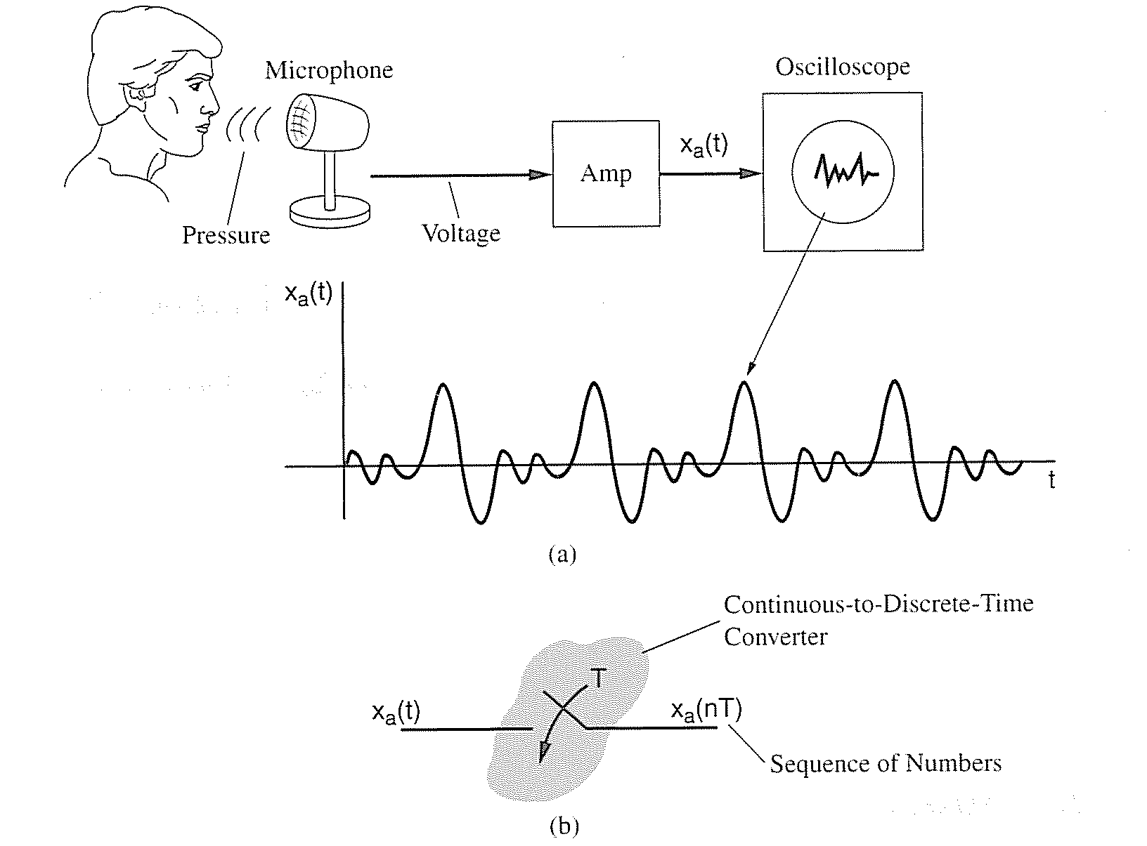
Figure 2.1
Measurement (a) and sampling (b) of an analog speech waveform
Veton Këpuska
Notes:
Digital Systems: Hardware Organization and Design
Architecture of a Respresentative 32 Bit Processor

Slide 8
Discrete-Time Signals (cont.)
The C/D converter, as depicted in Figure 2.1, generates the discrete-time signal that is characterized by infinite amplitude precision.
In practice however, a physical device does not achieve infinite precision:
  Analog-to-Digital (A/D) converter is an approximation to a C/D by quantizing each amplitude to a finite set of values closest to actual analog signal amplitude.
  Resulting digital signal is thus discrete in amplitude as well as time.
Associated with digital signals are digital systems whose inputs and outputs are likewise digital.
Veton Këpuska
Notes:
Digital Systems: Hardware Organization and Design
Architecture of a Respresentative 32 Bit Processor

Slide 9
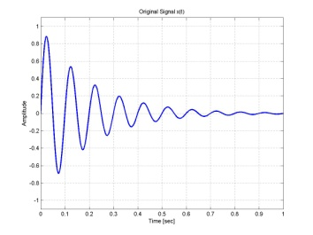
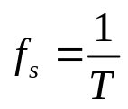
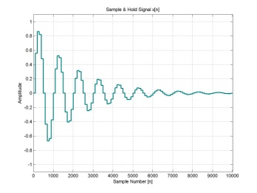


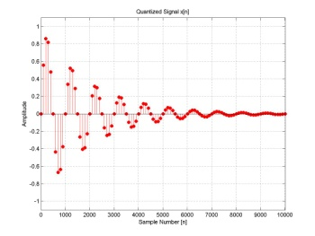
ADC: Time Quantization (Sampling) of Analog Signals
a)
b)
Analog-to-Digital Conversion.
Continuous Signal x(t).
Sampled signal with sampling period T satisfying Nyquist rate as specified by Sampling Theorem.
Digital sequence obtained after sampling and quantization x[n]
x(t)
Analog
Low-pass
Filter
Sample
and
Hold
Analog to Digital
Converter
DSP
c)
Veton Këpuska

Slide 10
Example
Assume that the input continuous-time signal is pure periodic signal represented by the following expression:
where A is amplitude of the signal, Ω₀ is angular frequency in radians per second (rad/sec), φ is phase in radians, and f₀ is frequency in cycles per second measured in Hertz (Hz).
Assuming that the continuous-time signal x(t) is sampled every T seconds or alternatively with the sampling rate of f_{s}=1/T, the discrete-time signal x[n] representation obtained by t=nT will be:
Veton Këpuska

Slide 11
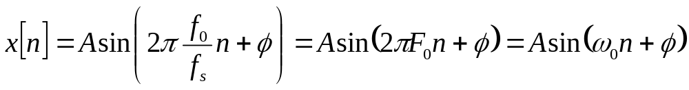
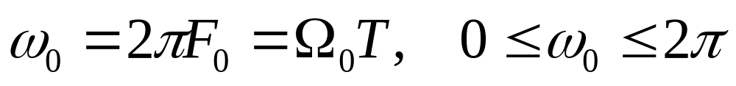
Example (cont.)
Alternative representation of x[n]:
reveals additional properties of the discrete-time signal.
The F₀= f₀/fs defines normalized frequency, and ω₀ digital frequency is defined in terms of normalized frequency:
Veton Këpuska

Slide 12
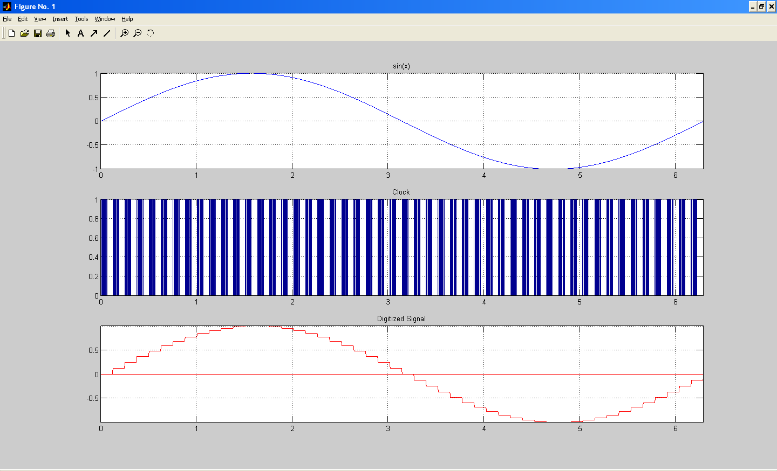
Example of ADC
Veton Këpuska
Notes:
Digital Systems: Hardware Organization and Design
Architecture of a Respresentative 32 Bit Processor

Slide 13
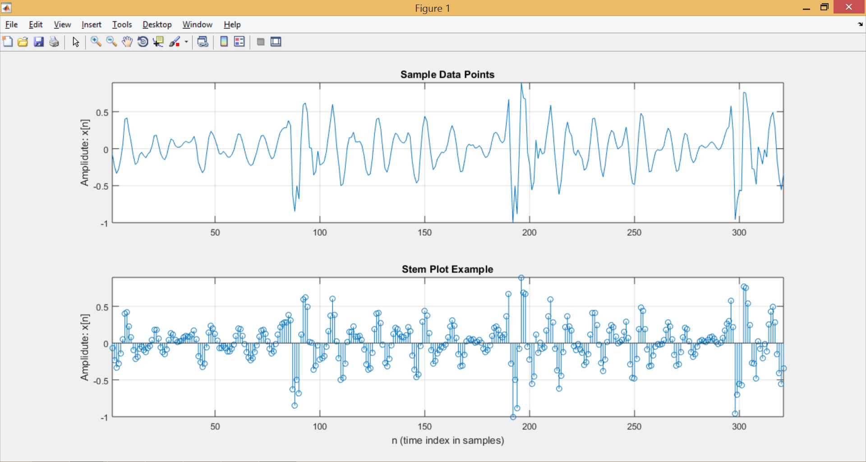
Example of Sampled Data
Veton Këpuska
Notes:
Digital Systems: Hardware Organization and Design
Architecture of a Respresentative 32 Bit Processor

Slide 14
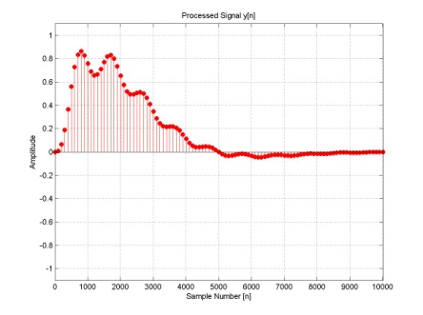
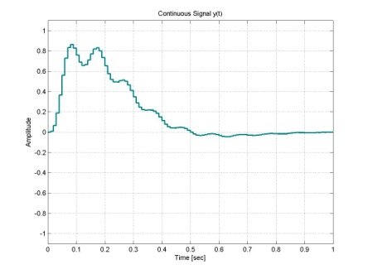

DAC: Reconstruction of Digital Signals
a)
b)
c)
DSP
Digital to
Analog Converter
Analog
Low-pass
Filter
y(t)
y[n]
y_{a}(nT)
Digital-to-Analog Conversion.
Processed digital signal y[n].
Continuous signal representation y_{a}(nT).
Low-pass filtered continuous signal y(t).
Veton Këpuska

Slide 15
Discrete Sequences
Veton Këpuska

Slide 16
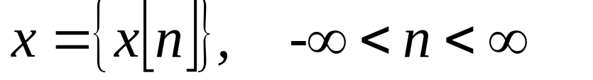
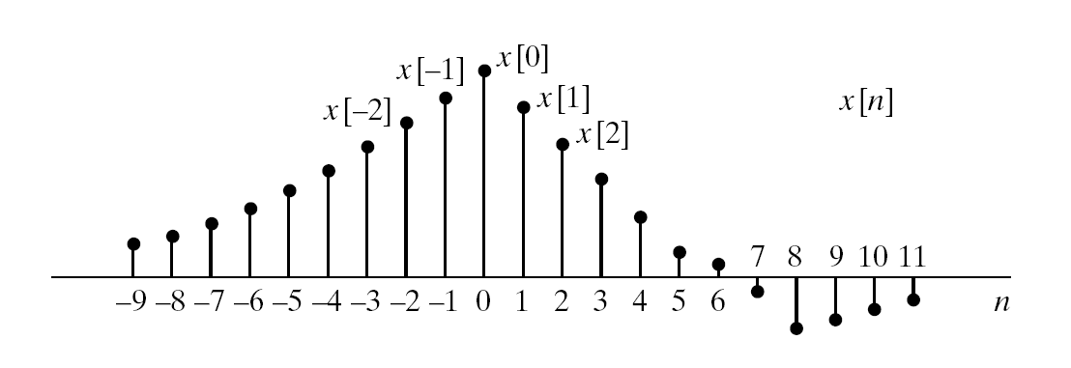
Discrete Sequences
Figure 2.1 Graphical representation of a discrete-time signal.
From Discrete-Time Signal Processing, 2e
by Oppenheim, Schafer, and Buck ©1999-2000 Prentice Hall, Inc.
Veton Këpuska
Notes:
Digital Systems: Hardware Organization and Design
Architecture of a Respresentative 32 Bit Processor

Slide 17
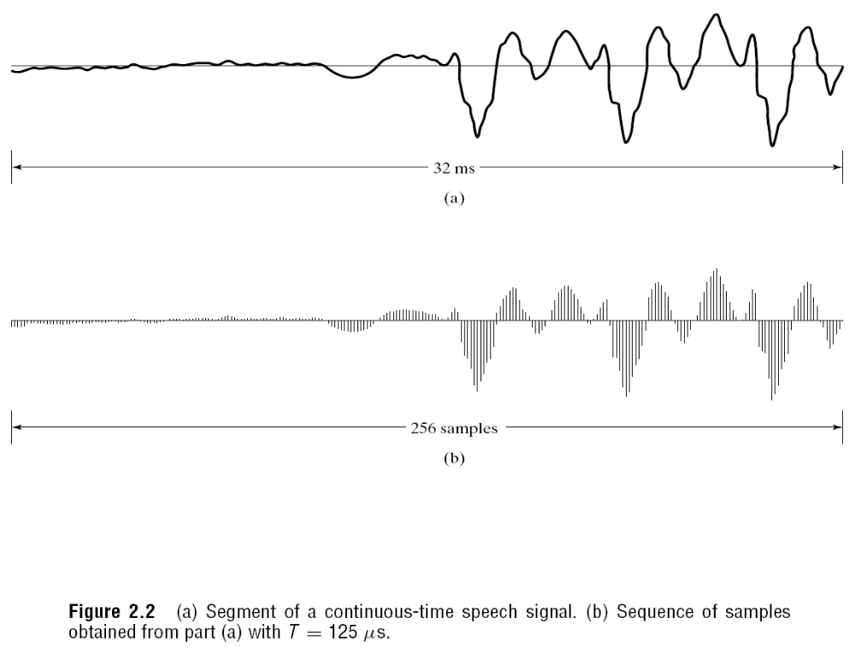
Conversion of Analog/Continuous Signal to Discrete Sample Sequence
Veton Këpuska
Notes:
Digital Systems: Hardware Organization and Design
Architecture of a Respresentative 32 Bit Processor

Slide 18
Special Discrete-Time Signals
Veton Këpuska

Slide 19
Discrete-Time Signals
In the realm of Digital Signal Processing a limited number of types of signals are used due to their specific properties.
In the next section those signals are introduced.
Each signal will be defined analytically as well as its graphical representation will be given.
Veton Këpuska
Notes:
Digital Systems: Hardware Organization and Design
Architecture of a Respresentative 32 Bit Processor

Slide 20
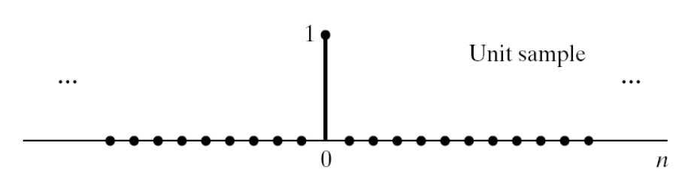
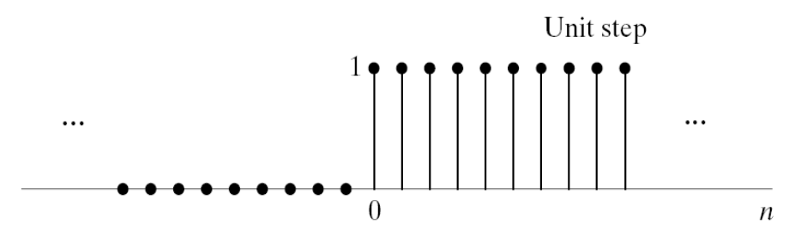
Discrete-Time Signals
Special Sequences
The unit sample or “impulse”:
      δ[n] = 1, n=0
      = 0, n≠0.
The unit step:
      u[n] = 1, n≥0
      = 0, n<0.
Veton Këpuska
Notes:
Digital Systems: Hardware Organization and Design
Architecture of a Respresentative 32 Bit Processor

Slide 21
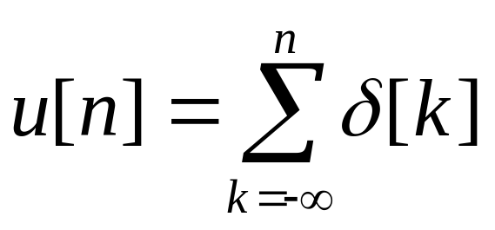
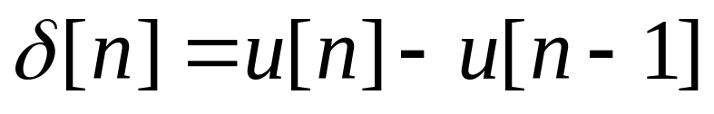
Discrete-Time Signals (cont.)
  Unit step sequence and unit sample can be expressed as a function of the other:
Veton Këpuska
Notes:
Digital Systems: Hardware Organization and Design
Architecture of a Respresentative 32 Bit Processor

Slide 22
Discrete-Time Signals (cont.)
The exponential sequence
  x[n] = Aα^{n}
  Properties:
    If A and α are real then x[n] is real.
    Moreover if 0≤α<1 & A>0, then the sequence x[n] is positive and decreasing with increasing n.
    If -1≤α≤0, then the decreasing sequence values alternate in sign.
Veton Këpuska
Notes:
Digital Systems: Hardware Organization and Design
Architecture of a Respresentative 32 Bit Processor

Slide 23
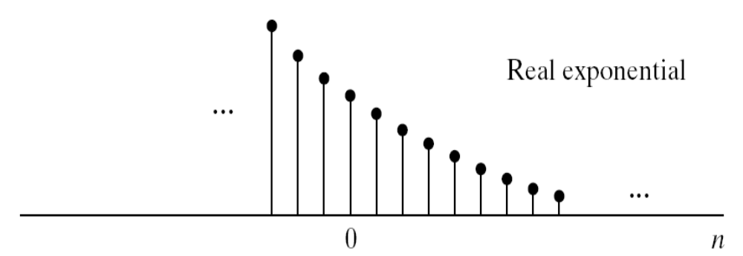
Real Exponential Sequence
From Discrete-Time Signal Processing, 2e
by Oppenheim, Schafer, and Buck ©1999-2000 Prentice Hall, Inc.
Veton Këpuska
Notes:
Digital Systems: Hardware Organization and Design
Architecture of a Respresentative 32 Bit Processor

Slide 24
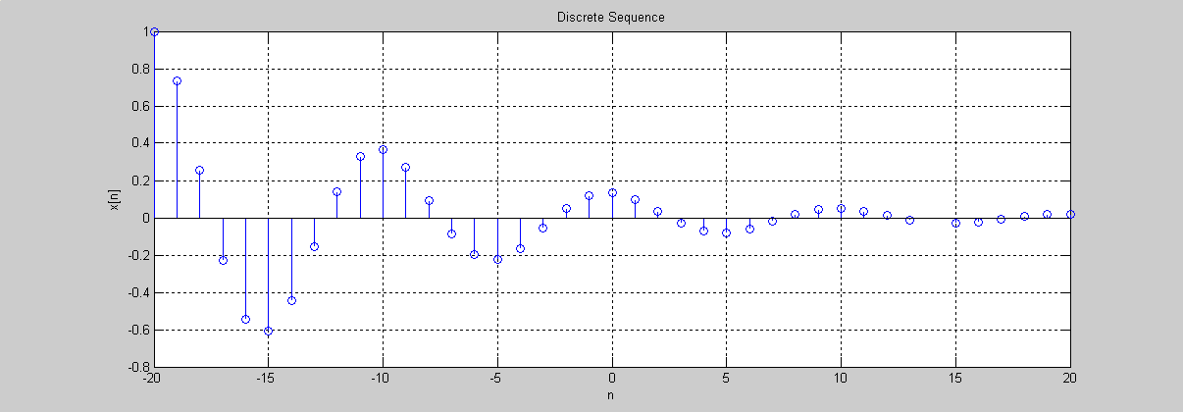
Matlab Stem Function
Veton Këpuska

Slide 25
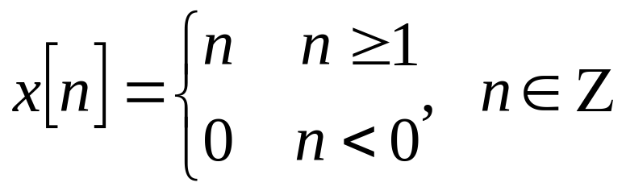
Graphical Representation of Discrete Time Signals
Example
x[n]
3
2
1
-3
-2
-1
0
1
2
3
n
Veton Këpuska
Notes:
Digital Systems: Hardware Organization and Design
Architecture of a Respresentative 32 Bit Processor

Slide 26
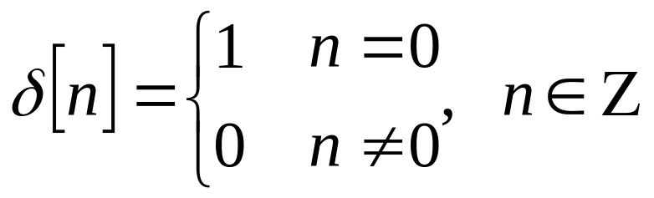
Special Types of Discrete Signals
Unit Impulse/Sample
δ[n]
1
-3
-2
-1
0
1
2
3
n
Veton Këpuska
Notes:
Digital Systems: Hardware Organization and Design
Architecture of a Respresentative 32 Bit Processor

Slide 27
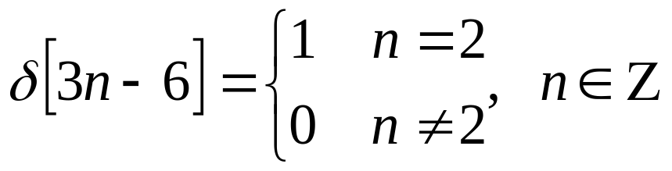
Special Types of Discrete Signals
Note: The unit impulse/sample δ takes the value of 1 whenever its argument (contained in []) becomes zero.
Example:
Veton Këpuska
Notes:
Digital Systems: Hardware Organization and Design
Architecture of a Respresentative 32 Bit Processor

Slide 28
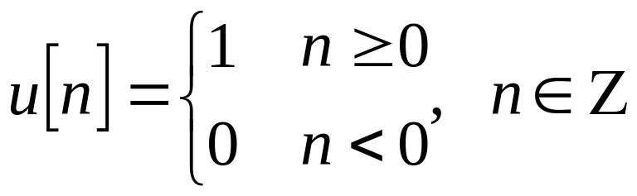
Special Types of Discrete Signals
Unit Step
u[n]
1
-3
-2
-1
0
1
2
3
n
Veton Këpuska
Notes:
Digital Systems: Hardware Organization and Design
Architecture of a Respresentative 32 Bit Processor

Slide 29
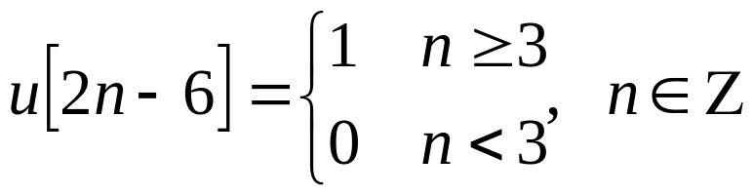
Special Types of Discrete Signals
Note: The unit step u takes the value of 1 whenever its argument (contained in []) is greater then zero.
Example:
Unit step sequence and unit sample can be expressed as a function of the other:
Veton Këpuska
Notes:
Digital Systems: Hardware Organization and Design
Architecture of a Respresentative 32 Bit Processor

Slide 30
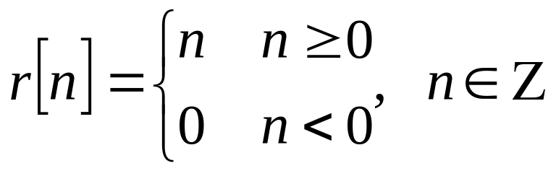
Special Types of Discrete Signals
Unit Ramp
r[n]
1
-3
-2
-1
0
1
2
3
n
Veton Këpuska
Notes:
Digital Systems: Hardware Organization and Design
Architecture of a Respresentative 32 Bit Processor

Slide 31
Special Types of Discrete Signals
Note: Unit ramp function r[n] can be expressed as function of unit sample function r[n]=nu[n]
Veton Këpuska
Notes:
Digital Systems: Hardware Organization and Design
Architecture of a Respresentative 32 Bit Processor

Slide 32
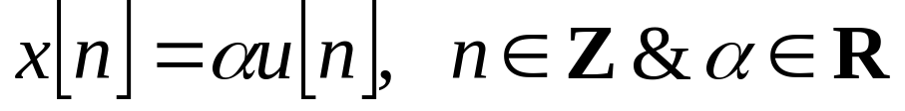
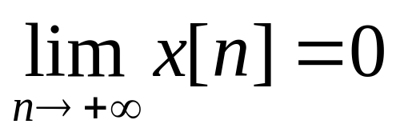
Special Types of Discrete Signals
Exponential Function
Note: The “shape” of the exponential signal dependents on the |α| and its sign|α|.
If |α|<1 then
Veton Këpuska
Notes:
Digital Systems: Hardware Organization and Design
Architecture of a Respresentative 32 Bit Processor

Slide 33
Special Types of Discrete Signals
r[n]
r[n]
1
1
-3
-2
-1
0
1
2
3
n
-3
-2
-1
0
1
2
3
n
α>1
0<α<1
Veton Këpuska
Notes:
Digital Systems: Hardware Organization and Design
Architecture of a Respresentative 32 Bit Processor

Slide 34
Special Types of Discrete Signals
r[n]
r[n]
1
1
-3
-2
-1
0
1
2
3
n
-3
-2
-1
0
1
2
3
n
α<-1
-1<α<0
Veton Këpuska
Notes:
Digital Systems: Hardware Organization and Design
Architecture of a Respresentative 32 Bit Processor

Slide 35
Discrete-Time Signals (cont.)
  The sinusoidal sequence
  x[n] = A cos(ωn+Φ)
    ω frequency of the sequence (in radians).
    A is magnitude of the sequence.
    Φ is the phase offset (in radians).
    Note that the discrete-time sinusoidal signal is periodic in the time variable n with period N only if N = 2πk/ω = integer.
Veton Këpuska
Notes:
Digital Systems: Hardware Organization and Design
Architecture of a Respresentative 32 Bit Processor

Slide 36
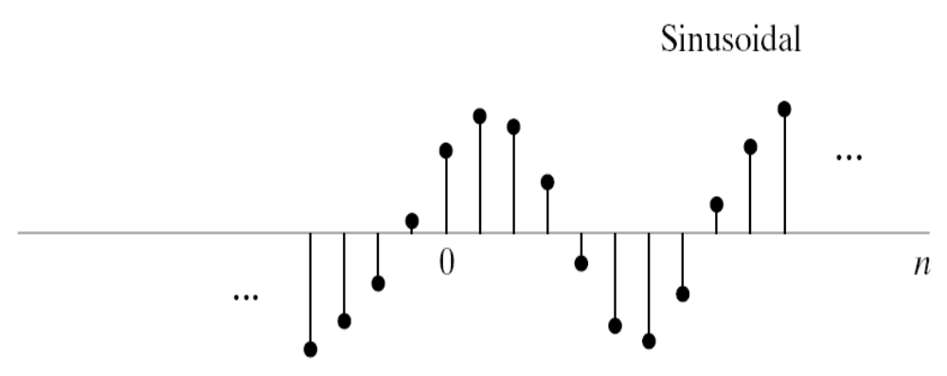
Real Sinusoidal Sequence
From Discrete-Time Signal Processing, 2e
by Oppenheim, Schafer, and Buck ©1999-2000 Prentice Hall, Inc.
Veton Këpuska
Notes:
Digital Systems: Hardware Organization and Design
Architecture of a Respresentative 32 Bit Processor

Slide 37
Discrete-Time Signals (cont.)
  Complex exponential sequence with complex gain A = |A|e^{jΦ} is written as:
    x[n] = Ae^{jωn}
    = |A|e^{jΦ}e^{jωn}
    = |A|cos(ωn+Φ) + j|A|sin(ωn+Φ)
    Important Property:
      Complex exponential is periodic in the frequency variable ω with period 2π:
      Ae^{j(ω+2π)n} = Ae^{jωn}
  In discrete time we need to consider frequencies only in the range 0≤ω≤2π.
Veton Këpuska
Notes:
Digital Systems: Hardware Organization and Design
Architecture of a Respresentative 32 Bit Processor

Slide 38
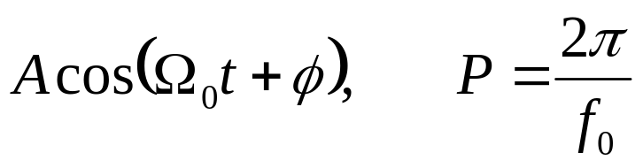
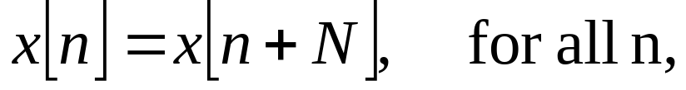
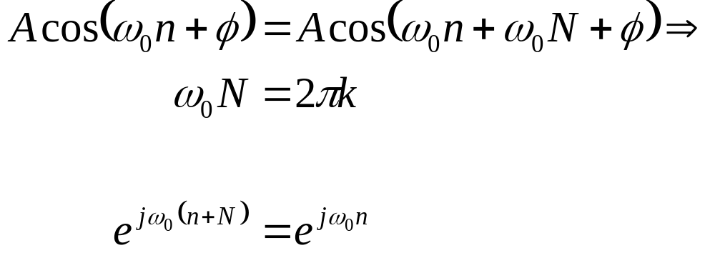
Discrete-Time Signals (cont.)
Periodicity of Discrete-Time Signals vs. Continuous Signals:
  Continuous Signals:
  Discrete-Time Signals: N
  Example:
Veton Këpuska
Notes:
Digital Systems: Hardware Organization and Design
Architecture of a Respresentative 32 Bit Processor

Slide 39
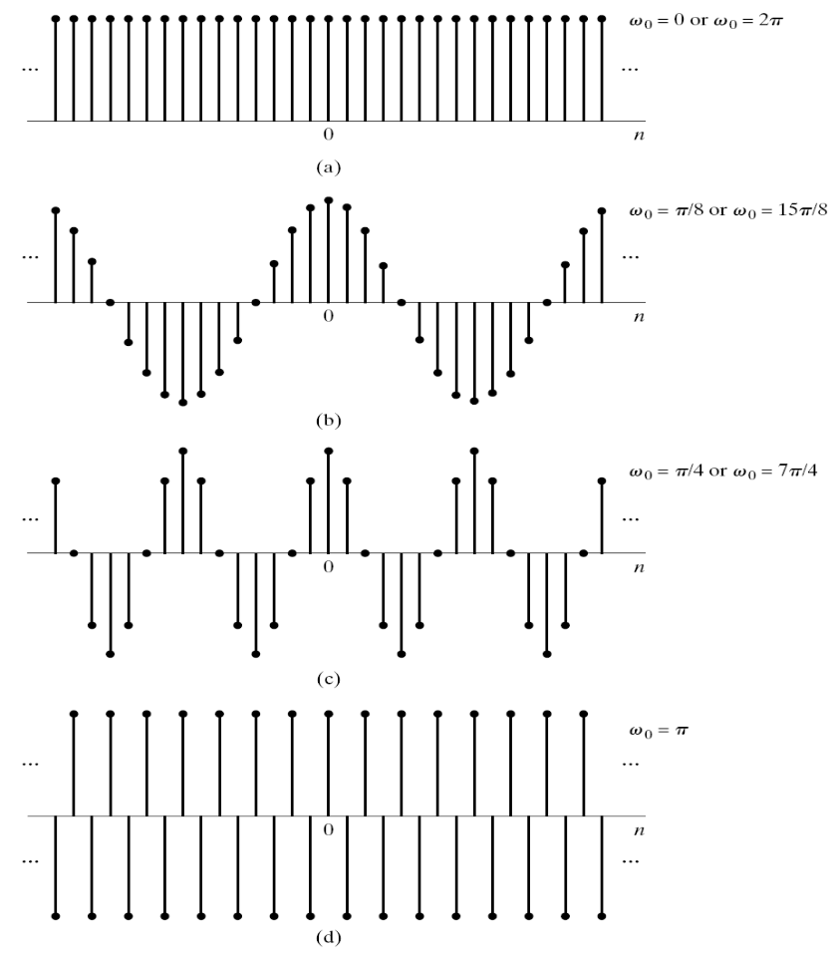
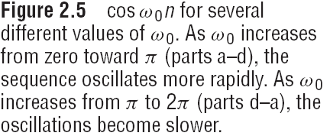
Periodic and A-periodic Discrete-time Sinusoids
From Discrete-Time Signal Processing, 2e
by Oppenheim, Schafer, and Buck ©1999-2000 Prentice Hall, Inc.
Veton Këpuska
Notes:
Digital Systems: Hardware Organization and Design
Architecture of a Respresentative 32 Bit Processor

Slide 40
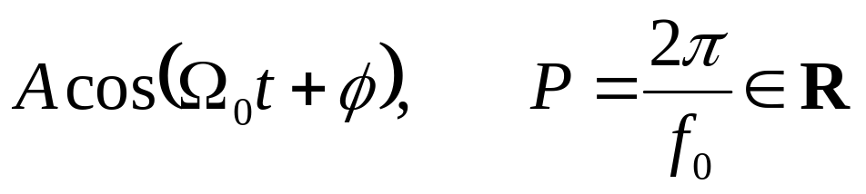
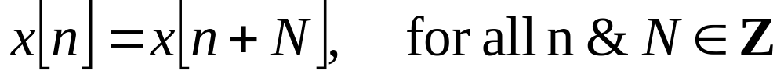
Periodic Discrete-Time Signals
Periodicity of Discrete-Time Signals vs. Continuous Signals:
  Continuous Signals:
  Discrete-Time Signals: A signal x is said to be periodic with period of N≠0 (we assume that N>0)if only if
Veton Këpuska
Notes:
Digital Systems: Hardware Organization and Design
Architecture of a Respresentative 32 Bit Processor

Slide 41
Periodic Discrete-Time Signals
Notes:
  It is necessary for N≠0, otherwise all signals would be periodic.
  If x is periodic with period of N, then it is also periodic with period of 2N, 3N, etc.
Definition: The smallest integer period of a periodic signal is called “fundamental period” of the signal.
Example
  x[n] = (-1)^{n}, ∀n: periodic with fundamental period of N=2
  x[n] = u[n], : a-periodic signal
Veton Këpuska
Notes:
Digital Systems: Hardware Organization and Design
Architecture of a Respresentative 32 Bit Processor

Slide 42
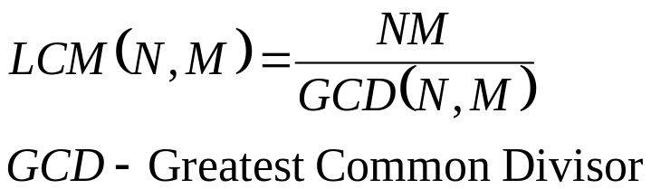
Periodic Discrete-Time Signals
Interesting Facts:
  Let x and y be two periodic signals with fundamental period N and M respectively.
  If
    z[n]=x[n]∓y[n] or
    z[n]=x[n]y[n] or
    z[n]=x[n]/y[n] (y[n]≠0, ∀n)
  Then
    z[n] is periodic with fundamental period of least common multiple LCM(N,M).
  LCM(N,M) is computed as:
Veton Këpuska
Notes:
Digital Systems: Hardware Organization and Design
Architecture of a Respresentative 32 Bit Processor

Slide 43
Formal Definitions of LCM & GCD
Definition 1
  We say that “d divides a”, if there exists an integer k such that a = kd. If d divides a and d ≥ 0, we say that d is a divisor of a.
  If d divides a and d divides b, then d is a common divisor of a and b.
Example 1
  Every integer d ≥ 0 (including d = 0) is a divisor of 0. While 0 divides no integer except itself, 1 is a divisor of every integer.
  The divisors of 12 are {1, 2, 3, 4, 6, 12}.
  A common divisor of 14 and 77 is 7.
  If d divides a then d divides -a.
Veton Këpuska
Notes:
Digital Systems: Hardware Organization and Design
Architecture of a Respresentative 32 Bit Processor

Slide 44
Formal Definitions of LCM & GCD
Definition 2 (prime)
  An integer p > 1 is prime if its only divisors are 1 and p.
Definition 3 (Greatest common divisor, relatively prime)
  The greatest common divisor, gcd(a, b), of two integers a and b is the largest of their common divisors, except that gcd(0; 0) = 0 by definition.
  Integers a and b are relatively prime if gcd(a, b) = 1.
Example 2
  gcd(24, 30) = 6
  gcd(4, 7) = 1
  gcd(0, 5) = 5
  gcd(-6, 10) = 2
Veton Këpuska
Notes:
Digital Systems: Hardware Organization and Design
Architecture of a Respresentative 32 Bit Processor

Slide 45
Formal Definitions of LCM & GCD
Example 3
  For all a ≥ 0, a and a + 1 are relatively prime. The integer 1 is relatively prime to all other integers.
Example 4
  If p is prime and 1 ≤ a < p, then gcd(a, p) = 1. That is, a and p are relatively prime.
Definition 4
  For any positive integer n, we define Euler’s phi function of n, denoted Φ(n), as the number of integers d, 1 ≤ d ≤ n, that are relatively prime to n. (Note that Φ(1) = 1.)
Veton Këpuska
Notes:
Digital Systems: Hardware Organization and Design
Architecture of a Respresentative 32 Bit Processor

Slide 46
Formal Definitions of LCM & GCD
Example 5
  If p is prime, then Φ(p) = p - 1. For any integer k > 0, Φ(2^{k}) = 2^{k-1}.
Definition 5
  The least common multiple lcm(a, b) of two integers a ≥ 0, b ≥ 0, is the least m such that a divides m and b divides m.
Exercise 1
  It can be shown that lcm(a,b) = ab/gcd(a/b).
Veton Këpuska
Notes:
Digital Systems: Hardware Organization and Design
Architecture of a Respresentative 32 Bit Processor

Slide 47
Periodic Discrete-Time Signals
Example: Let
  x periodic with fundamental period 5
  y periodic with fundamental period 10
  If z[n]=x[n]y[n] then z[n] is periodic with fundamental period LCM(5,10)=10
Veton Këpuska
Notes:
Digital Systems: Hardware Organization and Design
Architecture of a Respresentative 32 Bit Processor

Slide 48
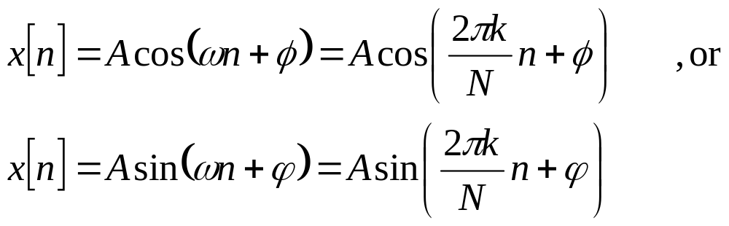
Special Periodic Discrete-Time Signals
  The sinusoidal sequence
    ω angular frequency of the sequence.
    A is magnitude of the sequence.
    Φ is the phase offset.
    Note that the discrete-time sinusoidal signal is periodic in the time variable n with period N only if N = 2πk/ω ∈ Z integer.
Veton Këpuska
Notes:
Digital Systems: Hardware Organization and Design
Architecture of a Respresentative 32 Bit Processor

Slide 49
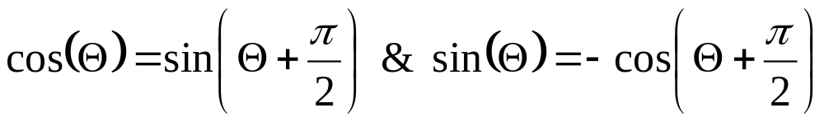
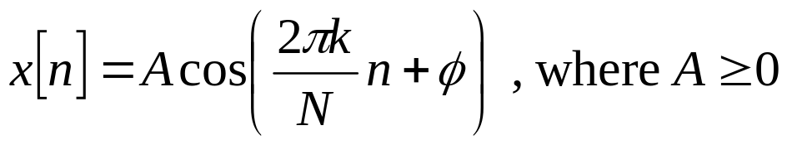
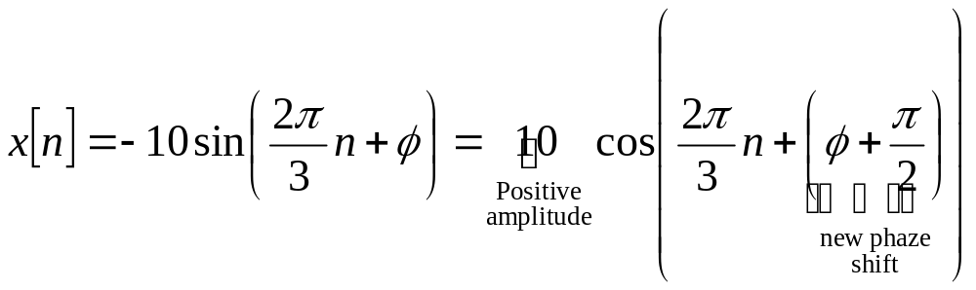
Special Periodic Discrete-Time Signals
Both formulations are called sinusoidal signals because a cosine can always be expressed as a sin-e function & vice-versa.
Using appropriate phase shifts one can always transform a sinusoidal signal in its standard form:
  Example:
Veton Këpuska
Notes:
Digital Systems: Hardware Organization and Design
Architecture of a Respresentative 32 Bit Processor

Slide 50
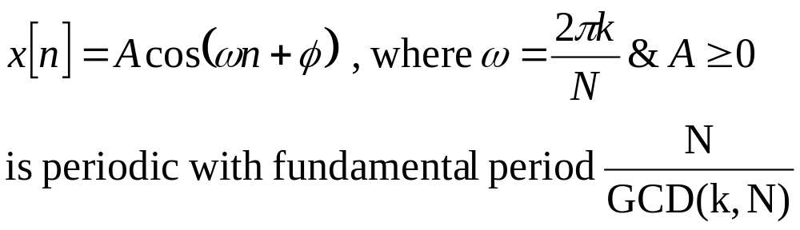
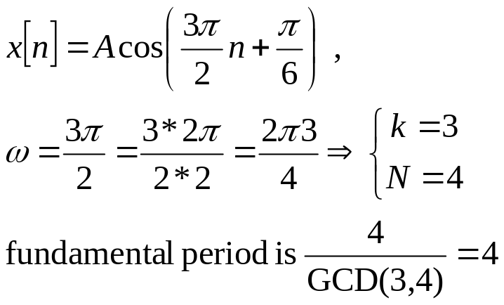
Special Periodic Discrete-Time Signals
Fact:
Example:
Veton Këpuska
Notes:
Digital Systems: Hardware Organization and Design
Architecture of a Respresentative 32 Bit Processor

Slide 51
Example
Find the condition for which the given discrete time signal is periodic.
Veton Këpuska
Notes:
Digital Systems: Hardware Organization and Design
Architecture of a Respresentative 32 Bit Processor

Slide 52
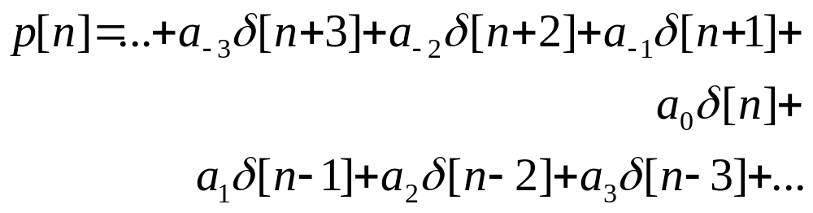
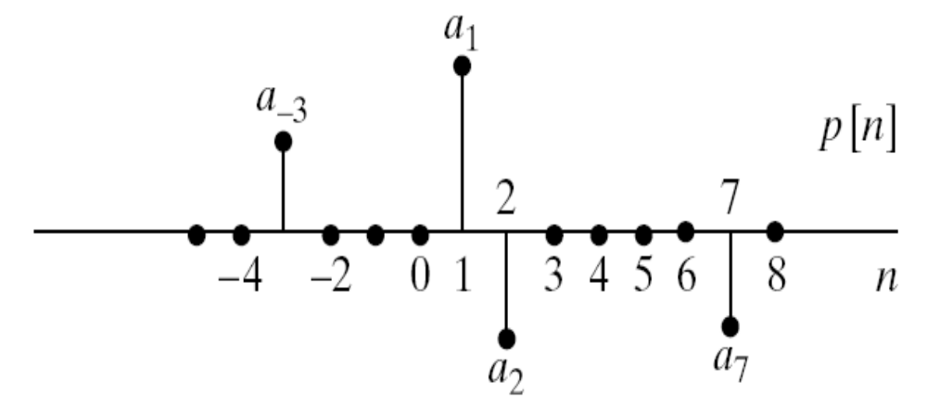
Sequence of a sum of scaled, delayed impulses
Any sequence (digital signal) can be expressed as a weighted sum of unit sample shifted in time; e.g.,:
Veton Këpuska
Notes:
Digital Systems: Hardware Organization and Design
Architecture of a Respresentative 32 Bit Processor

Slide 53
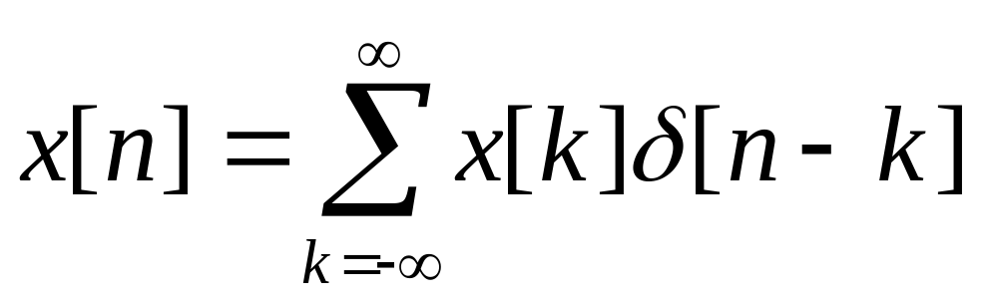
General representation of a sequence
Any sequence can be expressed as:
Veton Këpuska
Notes:
Digital Systems: Hardware Organization and Design
Architecture of a Respresentative 32 Bit Processor

Slide 54
Operations on Discrete-Time Signals
Notes:
Digital Systems: Hardware Organization and Design
Architecture of a Respresentative 32 Bit Processor

Slide 55
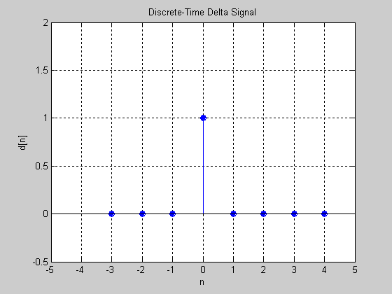
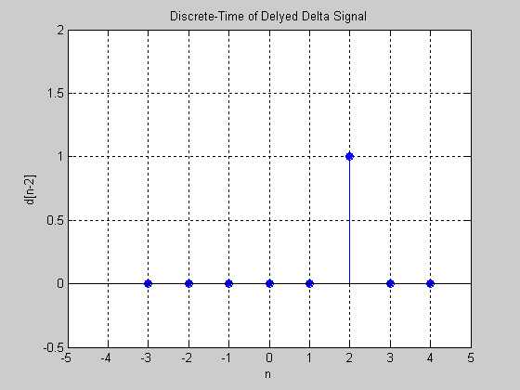
Time-Shift
Delay by n₀ samples
  n→n-n₀
Advance by n₀ samples
  n→n+n₀
Example:
δ[n]
δ[n-2]
Veton Këpuska
Notes:
Digital Systems: Hardware Organization and Design
Architecture of a Respresentative 32 Bit Processor

Slide 56
Time Reversal
Time reversal corresponds to reflection of the signal along n=0, the time axis (n → -n)
Example
  x[n]=δ[n-2]
  y[n]= x[-n]= δ[-n-2]= δ[-(n+2)]=δ[n+2]
  Comment: δ[n] is an even function of n, that is, δ[-n]= δ[n].
Veton Këpuska
Notes:
Digital Systems: Hardware Organization and Design
Architecture of a Respresentative 32 Bit Processor

Slide 57
Time Scaling
Time Scaling is achieved by following transformation of time variable n:
  n → rn
  where r ∈ Q (set of all rational numbers), r≠0
  If |r|<1, the it corresponds to expansion of the signal on the n-axis
  Otherwise, if |r|>1, it corresponds to of the contraction signal
Note:
  Reversal is a special case of time scaling (r=-1)
  If for some value of n the product rn is not an integer, we simply skip this value by setting it equal to 0.
Veton Këpuska
Notes:
Digital Systems: Hardware Organization and Design
Architecture of a Respresentative 32 Bit Processor

Slide 58
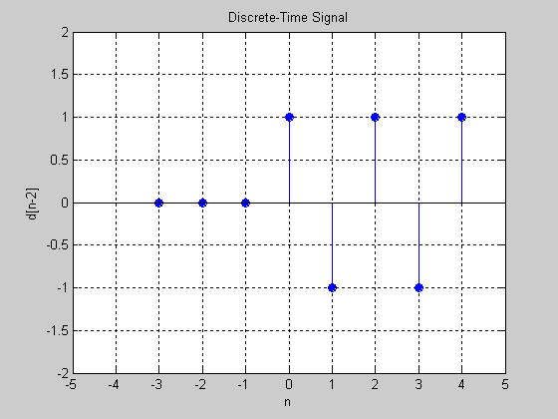
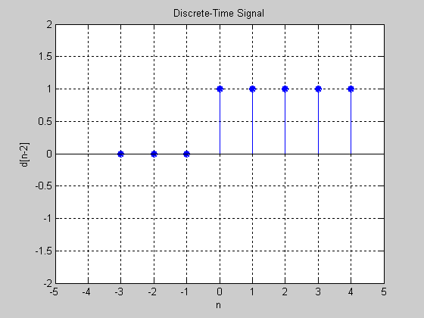
Examples
x[n] = (-1)^{n}u[n]
y[n] = x[2n]u[2n] = (-1)^{2n}u[2n]=[(-1)²]^{n}u[n] = (1)^{n}u[n] = u[n]
  Comment: Equivalence of u[2n]=u[n] was used in previous derivation. Show that this is correct and why?
x[n]
y[n]
Veton Këpuska
Notes:
Digital Systems: Hardware Organization and Design
Architecture of a Respresentative 32 Bit Processor

Slide 59
Examples
Comment:
  Contracting using r=2 caused y[n] to contain only every other sample of x[n]. In other words, y[n] is a sub-sampled (decimated) by 2 version of x[n].
Veton Këpuska
Notes:
Digital Systems: Hardware Organization and Design
Architecture of a Respresentative 32 Bit Processor

Slide 60

Examples
x[n]=u[n] n=0 y[0]=x[0]=1
y[n]=x[n/2] n=1 y[1]=x[1/2] – undefined
y[1]=0
n=2 y[2]=x[1]=1 …
x[n]
y[n]
Veton Këpuska
Notes:
Digital Systems: Hardware Organization and Design
Architecture of a Respresentative 32 Bit Processor

Slide 61
Examples
Comment:
  Expanding by a factor of 2 (r=1/2) caused y[n] to contain the samples of x interleased with zeros. This is called over-sampling (interpolation) by 2 with zero insertion.
Veton Këpuska
Notes:
Digital Systems: Hardware Organization and Design
Architecture of a Respresentative 32 Bit Processor

Slide 62
Additional Special Discrete-Signals
After presenting 3 basic operations on signals, the more elaborate ones can be defined next.
Veton Këpuska
Notes:
Digital Systems: Hardware Organization and Design
Architecture of a Respresentative 32 Bit Processor

Slide 63


Additional Special Discrete-Signals
(Rectangular) Pulse Signal
∏(n;n₁,n₂)
n₁
n₂
Duration of pulse: n₂-n₁+1 samples
Veton Këpuska
Notes:
Digital Systems: Hardware Organization and Design
Architecture of a Respresentative 32 Bit Processor

Slide 64

Relationship of Pulse with Step & Unit Impulse Signals
Veton Këpuska
Notes:
Digital Systems: Hardware Organization and Design
Architecture of a Respresentative 32 Bit Processor

Slide 65


Train of Pulses
For N≠0
T₃(n)
Veton Këpuska
Notes:
Digital Systems: Hardware Organization and Design
Architecture of a Respresentative 32 Bit Processor

Slide 66
Train of Pulses
Comment:
  T_{N}(n) is periodic with fundamental period N
  Note: T₁(n)=1 ∀n
Veton Këpuska
Notes:
Digital Systems: Hardware Organization and Design
Architecture of a Respresentative 32 Bit Processor

Slide 67
Representation of Signals as Superposition of Impulses
Any sequence (digital signal) can be expressed as a weighted sum of unit sample shifted in time; e.g.,:
Veton Këpuska
Notes:
Digital Systems: Hardware Organization and Design
Architecture of a Respresentative 32 Bit Processor

Slide 68
General Representation of a Sequence
Representation Theorem:
  In general, any sequence can be expressed as a weighted summation (superposition) of shifted unit impulses:
Veton Këpuska
Notes:
Digital Systems: Hardware Organization and Design
Architecture of a Respresentative 32 Bit Processor

Slide 69


Representation of Signals as Superposition of Impulses
Let:
Veton Këpuska
Notes:
Digital Systems: Hardware Organization and Design
Architecture of a Respresentative 32 Bit Processor

Slide 70

Representation of Signals as Superposition of Impulses
In a similar fashion; if x[n]=u[n], then
Veton Këpuska
Notes:
Digital Systems: Hardware Organization and Design
Architecture of a Respresentative 32 Bit Processor

Slide 71
Selected Problems with Solutions
Problem 1
  Show that r[n]=nu[n-1]
Solution:
  Considering that it has been shown that r[n]=nu[n], the stated problem states something strange. More specifically it needs to be shown that nu[n]=nu[n-1] ∀n.
  To demonstrate this equality the Representation Theorem will be utilized:
Veton Këpuska
Notes:
Digital Systems: Hardware Organization and Design
Architecture of a Respresentative 32 Bit Processor

Slide 72

Solution of the Problem 1
Veton Këpuska
Notes:
Digital Systems: Hardware Organization and Design
Architecture of a Respresentative 32 Bit Processor

Slide 73
Solution of the Problem 1 (cont.)
From (*) it can be observed that:
  r[n] = nδ[n]+nu[n-1]=nu[n-1], only if nδ[n]=0.
  Since δ[n]=1 for n=0 & δ[n]=0 for n≠0 ⇒ indeed nδ[n]=0.
Thus,
  r[n] = nu[n]=nu[n-1]
Comment:
  The fact that nδ[n]=0 ∀n, is a special case of the sifting property of the impulse function:
    x[n]δ[n-n₀]=x[n₀]δ[n-n₀] ∀n,n₀
Veton Këpuska
Notes:
Digital Systems: Hardware Organization and Design
Architecture of a Respresentative 32 Bit Processor

Slide 74

Problem 2
Show that:
  ∏(n-n₀;n₁,n₂)=∏(n;n₁+n₀,n₂+n₀)
Solution
Veton Këpuska
Notes:
Digital Systems: Hardware Organization and Design
Architecture of a Respresentative 32 Bit Processor

Slide 75
Problem 3
Simplify r[2n] by writing it as an expression of elementary functions.
Solution:
  r[2n]=(2n)u[2n]=(2n)u[n]=2nu[n]=2r[n]
Veton Këpuska
Notes:
Digital Systems: Hardware Organization and Design
Architecture of a Respresentative 32 Bit Processor

Slide 76


Problem 4
Express x[n], given below in terms of elementary signal:
Solution:
Veton Këpuska
Notes:
Digital Systems: Hardware Organization and Design
Architecture of a Respresentative 32 Bit Processor

Slide 77

Problem 5
Simplify y[n]=x[n]T_{N}(n)
  Hint: Use sifting property.
Solution
Veton Këpuska
Notes:
Digital Systems: Hardware Organization and Design
Architecture of a Respresentative 32 Bit Processor

Slide 78
Discrete-Time Systems
Notes:
Digital Systems: Hardware Organization and Design
Architecture of a Respresentative 32 Bit Processor

Slide 79
Discrete-Time System
A discrete–time system can be thought of as a transformation T(x) of an input sequence to an output sequence:
  y[n] = T{x[n]}
x[n]
T{●}
y[n]
Veton Këpuska
Notes:
Digital Systems: Hardware Organization and Design
Architecture of a Respresentative 32 Bit Processor

Slide 80

Discrete-Time Signals
A Discrete-Time Signal is a function of the sample index to set C:
  This function thus maps n ∈ Z to the value of the signal x[n].
Veton Këpuska
Notes:
Digital Systems: Hardware Organization and Design
Architecture of a Respresentative 32 Bit Processor

Slide 81

Discrete-Time Systems
A Discrete-Time System is a function of functions (operator) that takes an input signal and maps it to an output signal.
It is a mapping within the set of all complex valued signals S.
Veton Këpuska
Notes:
Digital Systems: Hardware Organization and Design
Architecture of a Respresentative 32 Bit Processor

Slide 82
Discrete-Time System
If T{x} is restricted to have properties of
  Linearity, and
  Time invariance,
  Then the system is referred to as linear time-invariant (LTI) system.
Veton Këpuska
Notes:
Digital Systems: Hardware Organization and Design
Architecture of a Respresentative 32 Bit Processor

Slide 83
Discrete-Time System (cont.)
Definition of LTI systems.
  x₁[n] and x₂[n] inputs to a discrete-time system.
  a & b, arbitrary constants, then
  The system is linear if and only if:
    T{ax₁[n] + bx₂[n]} = aT{x₁[n]} + bT{x₂[n]}
    Principle of superposition.
Veton Këpuska
Notes:
Digital Systems: Hardware Organization and Design
Architecture of a Respresentative 32 Bit Processor

Slide 84
Principle of Superposition.
T{ax₁[n] + bx₂[n]} = aT{x₁[n]} + bT{x₂[n]}
a
x₁
ax₁[n] + bx₂[n]
T{}
y= T{ax₁[n] + bx₂[n]}
x₂
b
a
T{}
aT{x₁[n]}
x₁
y= aT{x₁[n]}+bT{x₂[n]}
x₂
T{}
bT{x₂[n]}
b
Veton Këpuska
Notes:
Digital Systems: Hardware Organization and Design
Architecture of a Respresentative 32 Bit Processor

Slide 85
Principle of Superposition (cont.)
Another way of stating principle of superposition:
  Additive Property
    T{x₁[n] + x₂[n]} = T{x₁[n]} + T{x₂[n]}
  Scaling (Homogeneity) Property
  T{ax[n]} = a T{x[n]} = ay[n]
Veton Këpuska
Notes:
Digital Systems: Hardware Organization and Design
Architecture of a Respresentative 32 Bit Processor

Slide 86


Example of Accumulator System
The system defined by input-output equation:
defines an accumulator system.
It can be shown that accumulator system is Liner system:
Veton Këpuska
Notes:
Digital Systems: Hardware Organization and Design
Architecture of a Respresentative 32 Bit Processor

Slide 87

Example of Accumulator System (cont.)
When input x₃[n]:
    x₃[n] = ax₁[n] + bx₂[n]
Then
    y₃[n] = ay₁[n] + by₂[n], for all a & b.
Proof:
y₁[n]
y₂[n]
Veton Këpuska
Notes:
Digital Systems: Hardware Organization and Design
Architecture of a Respresentative 32 Bit Processor

Slide 88

Discrete-Time System (cont.)
  Time-Invariance:
    If y[n] = T(x[n])
    then y[n-n₀] = T(x[n-n₀])
  LTI system is completely characterized by its impulse response h[n]:
    Impulse response is defined as the system’s response to a unit sample (or impulse).
    “*” denotes the convolution operator.
Veton Këpuska
Notes:
Digital Systems: Hardware Organization and Design
Architecture of a Respresentative 32 Bit Processor

Slide 89

Unit Sample Response and LTI
Any sequence (digital signal) can be expressed as a weighted sum of unit sample shifted in time; e.g.,:
In General:
On the other hand:
Veton Këpuska
Notes:
Digital Systems: Hardware Organization and Design
Architecture of a Respresentative 32 Bit Processor

Slide 90

Unit Sample Response and LTI
By applying Superposition Principle and Linear Time Invariance we can derive expression that defines convolution:
Veton Këpuska
Notes:
Digital Systems: Hardware Organization and Design
Architecture of a Respresentative 32 Bit Processor

Slide 91


Accumulator is Time Invariant System
Proof:
Veton Këpuska
Notes:
Digital Systems: Hardware Organization and Design
Architecture of a Respresentative 32 Bit Processor

Slide 92
Discrete-Time Systems
  If x[n] sequence is of length M and h[n] sequence is of length L, the length of the resulting output sequence y[n] is:
  M+L-1
  Convolution is commutative:
  x[n]*h[n] = h[n]*x[n]
  Convolution operation with h[n] is sometimes referred to as filtering the input x[n] by the system h[n]. h[n] may thus perform a useful operation in our modeling of speech production and in almost all speech processing systems.
Veton Këpuska
Notes:
Digital Systems: Hardware Organization and Design
Architecture of a Respresentative 32 Bit Processor

Slide 93
Convolution Computation
When viewed as a formula for computing a single value of the output sequence y[n] (equation in the previous slide) is obtained by
  multiplying the
    input sequence (expressed as function of k) x[k]δ[n-k], by
    the sequence whose values are h[n-k],
    -∞<k<∞
  and then for any fixed value of n summing
    all the values of the products (output sequence) x[k]h[n-k], with k, a counting index in the summation process.
Veton Këpuska
Notes:
Digital Systems: Hardware Organization and Design
Architecture of a Respresentative 32 Bit Processor

Slide 94


Convolution Example
Figure 2.8 Representation of the output of a linear time-invariant system as the superposition of responses to individual samples of the input.
Veton Këpuska
Notes:
Digital Systems: Hardware Organization and Design
Architecture of a Respresentative 32 Bit Processor

Slide 95
Convolution Computation
Convolution, involves doing the computation on two sequences for all values of n generating this a complete output sequence y[n], -∞<n<∞
Key to this other interpretation of this computation is understanding how to form the sequence h[n-k],
-∞<k<∞ for all values of n that are of interest.
To this end, it is useful to note that
  h[n-k] = h[-(k-n)]
Veton Këpuska
Notes:
Digital Systems: Hardware Organization and Design
Architecture of a Respresentative 32 Bit Processor

Slide 96


Convolution (cont.)
Veton Këpuska
Notes:
Digital Systems: Hardware Organization and Design
Architecture of a Respresentative 32 Bit Processor

Slide 97
Discrete-Time Systems
Properties of LTI
Notes:
Digital Systems: Hardware Organization and Design
Architecture of a Respresentative 32 Bit Processor

Slide 98

Properties of LTI:
Stability:
  Every bounded input produces a bounded output:
    If |x[n]| < ∞, then |y[n]| < ∞ for all n.
  Necessary and sufficient condition for stability is that h[n] be absolutely summable:
Veton Këpuska
Notes:
Digital Systems: Hardware Organization and Design
Architecture of a Respresentative 32 Bit Processor

Slide 99
Properties of LTI:
Causality:
  A causal system is one where for any time instant n₀, y[n₀] does not depend on x[n] for n>n_{0:}
    Output does not depend on the future values of the input.
  A necessary and sufficient condition for causality is that:
    h[n] = 0, for n<0.
  A consequence of causality is that for the system
  y[n] = T(x[n]):
    if x₁[n] = x₂[n] for n<n₀,
    then y₁[n] = y₂[n] for n<n₀,
Veton Këpuska
Notes:
Digital Systems: Hardware Organization and Design
Architecture of a Respresentative 32 Bit Processor

Slide 100

Example 2.1
Assume that an LTI system has an exponentially decaying impulse response:
  h[n] = Aa^{n} for n≥0
  Causality:
    h[n] = 0 for n<0
  Stability:
    |a| < 1 the system is stable because the impulse response is absolutely summable:
Veton Këpuska
Notes:
Digital Systems: Hardware Organization and Design
Architecture of a Respresentative 32 Bit Processor

Slide 101
Properties of LTI Systems (cont).
h1[n]
x[n]
h₁[n]
h₂[n]
y[n]
x[n]
y[n]
x[n]
h₂[n]
h₁[n]
y[n]
h₂[n]
x[n]
h₁[n]*h₂[n]
y[n]
x[n]
h₁[n]+h₂[n]
y[n]
x[n]
h₂[n]*h₁[n]
y[n]
x[n]
h₂[n]+h₁[n]
y[n]
Veton Këpuska
Notes:
Digital Systems: Hardware Organization and Design
Architecture of a Respresentative 32 Bit Processor

Slide 102


Liner Constant-Coefficient Difference Equations
Nth-order linear constant-coefficient difference equation of the form
Accumulator Example
Veton Këpuska
Notes:
Digital Systems: Hardware Organization and Design
Architecture of a Respresentative 32 Bit Processor

Slide 103

Liner Constant-Coefficient Difference Equations (cont.)
x[n]
y[n]
One-sample delay
y[n-1]
Veton Këpuska
Notes:
Digital Systems: Hardware Organization and Design
Architecture of a Respresentative 32 Bit Processor

Slide 104

General Formulation of Difference Equation
Equation:
Along with initial conditions:
  y[-1], y[-2], …, y[-N]
  Uniquely specifies the LTI system.
General equation must be computed using recursive procedure.
Veton Këpuska
Notes:
Digital Systems: Hardware Organization and Design
Architecture of a Respresentative 32 Bit Processor

Slide 105
Example
Recursive Computation of Difference Equations:
      y[n] = ay[n-1]+x[n]
      Initial condition is given by y[-1] = c;
      Input x[n] = Kδ[n]
Veton Këpuska
Notes:
Digital Systems: Hardware Organization and Design
Architecture of a Respresentative 32 Bit Processor

Slide 106
Example (cont.)
Solution n≥0:
      y[0] = ac+K
      y[1] = ay[0]+0 = a(ac+K) = a²c+aK
      …
      y[n] = a^{n+1}c+a^{n}K, n≥0
Veton Këpuska

Slide 107
Example (cont.)
Solution n<0:
  y[n] = ay[n-1]+x[n] ➲ y[n-1] = a⁻¹(y[n]-x[n])
      y[-1] = c
      y[-2] = a⁻¹(y[-1]-x[-1]) = a⁻¹ (c+0) = a⁻¹c
      …
      y[n] = a^{n+1}c, n<0
Overall solution
      y[n] = a^{n+1}c+Ka^{n}u[n], ∀n
Veton Këpuska
Notes:
Digital Systems: Hardware Organization and Design
Architecture of a Respresentative 32 Bit Processor

Slide 108
Discrete-Time Fourier Transform
Notes:
Digital Systems: Hardware Organization and Design
Architecture of a Respresentative 32 Bit Processor

Slide 109
Discrete-Time Fourier Transform
Frequency domain representations are useful for:
  The analysis of signals and
  The design of systems for processing signals.
This is in contrast to previous section that focused on the time-domain representation of signals and systems.
A large class of sequences can be represented as a linear combination of complex exponentials whose frequencies lie in the range [-π, π].
Veton Këpuska
Notes:
Digital Systems: Hardware Organization and Design
Architecture of a Respresentative 32 Bit Processor

Slide 110

Discrete-Time Fourier Transform
Discrete-Time Fourier Transform pair of a sequence (x[n]):
First equation is inverse Fourier Transform
“synthesis equation”
“analysis equation”
Veton Këpuska
Notes:
Digital Systems: Hardware Organization and Design
Architecture of a Respresentative 32 Bit Processor

Slide 111
Discrete-Time Fourier Transform
The DTF transformed pair exists for a class of sequences:
  Existence means that
    X(ω) does not diverge,
    x[n] can be obtained from X(ω).
It can be shown that a sufficient condition for the existence of the DFT pair is that x[n] be absolutely summable; that is x[n] is stable:
  All stable sequences and stable system impulse responses have Fourier transforms.
Veton Këpuska
Notes:
Digital Systems: Hardware Organization and Design
Architecture of a Respresentative 32 Bit Processor

Slide 112



Discrete-Time Fourier Transform
Properties of the Fourier Transform:
  FT is a Complex Function
  FT is periodic with period 2π
  For a real-valued sequence x[n], the FT is conjugate-symmetric
Veton Këpuska
Notes:
Digital Systems: Hardware Organization and Design
Architecture of a Respresentative 32 Bit Processor

Slide 113



Discrete-Time Fourier Transform
    Conjugate symmetry implies that
      the magnitude and real part of X(ω) are even:
      Phase and imaginary parts are odd:
  Parseval’s Theorem: Energy of a signal
Veton Këpuska
Notes:
Digital Systems: Hardware Organization and Design
Architecture of a Respresentative 32 Bit Processor

Slide 114

Discrete-Time Fourier Transform
  Shift Property
Veton Këpuska
Notes:
Digital Systems: Hardware Organization and Design
Architecture of a Respresentative 32 Bit Processor

Slide 115

Example 2.2
Consider the shifted unit sample:
x[n]=δ[n-n₀]
The FT of x[n] is given by:
Note:
  FT of x[n] is complex function with unity magnitude and a linear phase of slope -n₀
  In time, energy of the signal is concentrated at n=n₀
  In frequency, the energy is uniformly distributed over the interval [-π,π].
Veton Këpuska
Notes:
Digital Systems: Hardware Organization and Design
Architecture of a Respresentative 32 Bit Processor

Slide 116

Example 2.3
Consider the decaying exponential sequence multiplied by the unit step:
x[n]=a^{n}u[n]
  a - complex
FT of x[n]:
Veton Këpuska
Notes:
Digital Systems: Hardware Organization and Design
Architecture of a Respresentative 32 Bit Processor

Slide 117


Example 2.3
If the sequence is multiplied by the complex exponential e^{jω0n}:
Using linearity (superposition) property of FT and the previous relation, the FT transform pair for a real decaying sinewave can be derived:
Veton Këpuska
Notes:
Digital Systems: Hardware Organization and Design
Architecture of a Respresentative 32 Bit Processor

Slide 118
Example 2.3
Figure 2.2 (next slide) illustrates the implications of conjugate symmetry of the FT magnitude and phase of this real sequence:
  The magnitude function is even
  The phase function is odd.
  Note also that faster the change (decreasing the value of a) of time sequence the broader the positive and negative frequency components of the signal around the frequencies ω₀ and –ω₀ respectively
Example 2.3 and Figure 2.2 illustrate a fundamental property of the FT:
  A signal cannot be arbitrarily narrow in time and in frequency.
Veton Këpuska
Notes:
Digital Systems: Hardware Organization and Design
Architecture of a Respresentative 32 Bit Processor

Slide 119


Figure 2.2
Frequency response of decaying complex and real exponentials
Solid line for slow decay [a=0.9] and dashed for fast decay [a=0.7]
Veton Këpuska
Notes:
Digital Systems: Hardware Organization and Design
Architecture of a Respresentative 32 Bit Processor

Slide 120


Example 2.4
Assume that the spectrum of the sequence is represented by the train of scaled unit impulses in frequency domain:
  Periodicity is enforced by adding delta function replicas at multiples of 2π.
The inverse FT is given by:
Veton Këpuska
Notes:
Digital Systems: Hardware Organization and Design
Architecture of a Respresentative 32 Bit Processor

Slide 121
Example 2.4
Important Observation:
  Obtained Fourier Transform (FT) pair represents the time-frequency dual of the shifted unit sample δ[n-n₀] and its transform e^{jω0n}.
  Shifted Fourier transform X(ω-ω₀) corresponds to the sequence x[n]e^{jω0n}
  -a property alluded earlier.
Veton Këpuska
Notes:
Digital Systems: Hardware Organization and Design
Architecture of a Respresentative 32 Bit Processor

Slide 122

Figure 2.3
Veton Këpuska
Notes:
Digital Systems: Hardware Organization and Design
Architecture of a Respresentative 32 Bit Processor

Slide 123


Discrete-Time Fourier Transform
Generalized Properties derived from Example 2.4
  Sinusoidal sequence
  Multiple complex exponential
  Multiple sinusoidals
Veton Këpuska
Notes:
Digital Systems: Hardware Organization and Design
Architecture of a Respresentative 32 Bit Processor

Slide 124
Uncertainty Principle
A signal cannot be arbitrarily narrow in time and in frequency.
FT increases in spread as the time sequence decreases in width.
This property of FT is formalized with the Uncertainty Principle:
  Formal definitions are needed of the width of a signal and it’s FT. They are referred to as duration, D(x), and bandwidth, B(x), respectively:
Veton Këpuska
Notes:
Digital Systems: Hardware Organization and Design
Architecture of a Respresentative 32 Bit Processor

Slide 125



Uncertainty Principle
- is the average time of the signal.
- is the average frequency of the signal.
Veton Këpuska
Notes:
Digital Systems: Hardware Organization and Design
Architecture of a Respresentative 32 Bit Processor

Slide 126


Uncertainty Principle
In order for time and frequency averages to be meaningful, it is assumed that:
  The signal energy is unity:
  Or that the signal has been normalized by its energy.
Uncertainty principle states that the product of signal duration and bandwidth cannot be less than a fixed limit:
Veton Këpuska
Notes:
Digital Systems: Hardware Organization and Design
Architecture of a Respresentative 32 Bit Processor

Slide 127
Uncertainty Principle
Remark:
  For real sequences, from the conjugate-symmetry property => the magnitude is even:
    the average frequency is zero and
    the bandwidth is determined by the distance between the spectral energy concentrations in positive and negative frequency.
    Thus, the resulting bandwidth is not necessarily indicative of the distribution of energy of physically meaningful quantities (e.g., in speech) such as system resonances.
  Consequently:
    Only complex sequences, or
    Only the positive frequencies of a real sequence are used in computing bandwidth.
Veton Këpuska
Notes:
Digital Systems: Hardware Organization and Design
Architecture of a Respresentative 32 Bit Processor

Slide 128


Uncertainty Principle
For real sequences the sequence s[n] is formed that has Fourier Transform:
S(ω) is assumed implicitly that is periodic with period of 2π
The sequence s[n] must be complex because conjugate symmetry is not satisfied. Thus
Veton Këpuska
Notes:
Digital Systems: Hardware Organization and Design
Architecture of a Respresentative 32 Bit Processor

Slide 129
Uncertainty Principle
s[n] -- inverse FT of S(ω), is called analytic signal representation of x[n]
It can be shown that:
  s_{r}[n] = x[n]/2
  s_{i}[n] – can be obtained from s_{r}[n] through the frequency domain operation:
    S_{i}(ω)= H(ω) S_{r}(ω)
    H(ω) – is called Hilbert transformer and is given by:
    H(ω) = -j, 0≤ ω <π
    H(ω) = j, -π ≤ ω <0
Veton Këpuska
Notes:
Digital Systems: Hardware Organization and Design
Architecture of a Respresentative 32 Bit Processor

Slide 130
Z-Transform
Veton Këpuska

Slide 131


Z-Transform
A limitation of the Fourier transform is that it cannot represent unstable sequences (i.e., sequences that are not absolutely summable)
The z-transform is a generalization of the Fourier transform that allows transformation for a much larger class of sequences and is given by:
The above expression is an infinite geometric series in the complex variable z=re^{jω}.
For r=1, z-transform reduces to Fourier transform.
Veton Këpuska
Notes:
Digital Systems: Hardware Organization and Design
Architecture of a Respresentative 32 Bit Processor

Slide 132


Z-Transform
Z-Transform is a generalization of the Fourier transform.
It also allows a broader class of sequences that are not absolutely summable to converge:
Where may be absolutely summable when x[n] is not.
Veton Këpuska
Notes:
Digital Systems: Hardware Organization and Design
Architecture of a Respresentative 32 Bit Processor

Slide 133

Z-Transform
Region of convergence (ROC) of the z-transform is defined as all values of r such that:
This condition of absolute summabilty is a sufficient condition for the convergence of X(z).
ROC can be viewed in the z-plane since
|z| = |re^{jω}| = r.
For r = 1, the z-transform becomes Fourier transform and so the Fourier transform exists if the ROC includes the unit circle.
Veton Këpuska
Notes:
Digital Systems: Hardware Organization and Design
Architecture of a Respresentative 32 Bit Processor

Slide 134

Z-Transform
Inverse Z-Transform. The Z-transform pair is given as:
Integral in the inverse transform is taken over contour C:
  a counterclockwise closed contour in the ROC of X(z) encircling the origin in the z-pane.
It can be formally evaluated using residue theory (A.V. Oppenheim and R.W. Schafer, “Discrete-Time Signal Processing”, Prentice Hall, 1989)
Veton Këpuska
Notes:
Digital Systems: Hardware Organization and Design
Architecture of a Respresentative 32 Bit Processor

Slide 135

Z-Transform
Interesting specific class of rational functions of the form:
Roots of the polynomial P(z) define the zeros, and
Roots of the polynomial Q(z) define the poles of the z-transform.
Partial fraction expansion method can be used for rational functions.
Veton Këpuska
Notes:
Digital Systems: Hardware Organization and Design
Architecture of a Respresentative 32 Bit Processor

Slide 136

Z-Transform
Find Z -transform and ROC
  Example 2.5 Consider the shifted impulse response:
  x[n] = δ[n-n₀]
  Solution:
  ROC includes entire Z plane excluding z = 0 for n₀>0.
Veton Këpuska
Notes:
Digital Systems: Hardware Organization and Design
Architecture of a Respresentative 32 Bit Processor

Slide 137

Z-Transform
  Consider the difference of unit samples:
    x[n] = δ[n] - aδ[n-1]
  Solution:
  ROC ∀z and z ≠ 0;
    X(z) has a pole at z = 0, i.e., the transform goes to infinity.
    Also X(z) = 0 for z = a, thus it has a zero at a.
Veton Këpuska
Notes:
Digital Systems: Hardware Organization and Design
Architecture of a Respresentative 32 Bit Processor

Slide 138

Z-Transform – Example 2.5
Veton Këpuska
Notes:
Digital Systems: Hardware Organization and Design
Architecture of a Respresentative 32 Bit Processor

Slide 139

Z-Transform
  Example 2.6
  Consider decaying exponential: x[n] = a^{n}u[n]. Find its Z-Transform.
  Solution:
Veton Këpuska
Notes:
Digital Systems: Hardware Organization and Design
Architecture of a Respresentative 32 Bit Processor

Slide 140

Z-Transform- Example 2.6
Veton Këpuska
Notes:
Digital Systems: Hardware Organization and Design
Architecture of a Respresentative 32 Bit Processor

Slide 141

Z-Transform
  Example 2.7:
  Let x1[n] and x2[n] denote the decaying exponential and its time-reversal, respectively. Then the sum of the two sequences is given by:
  Solution:
Veton Këpuska
Notes:
Digital Systems: Hardware Organization and Design
Architecture of a Respresentative 32 Bit Processor

Slide 142

Z-Transform- Example 2.7
Rewriting X(Z):
Veton Këpuska
Notes:
Digital Systems: Hardware Organization and Design
Architecture of a Respresentative 32 Bit Processor

Slide 143

Z-Transform- Example 2.7
ROC
Veton Këpuska
Notes:
Digital Systems: Hardware Organization and Design
Architecture of a Respresentative 32 Bit Processor

Slide 144

Z-Transform
For general rational X(Z), factoring P(Z) and Q(Z) gives:
  For |a_{k}|,|b_{k}|,|c_{k}|,|d_{k}| < 1
    (1-a_{k}z⁻¹) & (1-c_{k}z⁻¹); zeros and poles inside the unit circle.
    (1-b_{k}z) & (1-d_{k}z); zeros and poles outside the unit circle.
    z^{-r} delay
  For x[n] real sequence, poles and zeros occur in complex conjugate pairs.
Veton Këpuska
Notes:
Digital Systems: Hardware Organization and Design
Architecture of a Respresentative 32 Bit Processor

Slide 145

Z-Transform
Veton Këpuska
Notes:
Digital Systems: Hardware Organization and Design
Architecture of a Respresentative 32 Bit Processor

Slide 146

Z-Transform
When x[n] is stable and causal:
  Because the unit circle must be included in ROC =>
  All poles are inside the unit circle and the ROC is outside the outermost pole:
Veton Këpuska
Notes:
Digital Systems: Hardware Organization and Design
Architecture of a Respresentative 32 Bit Processor

Slide 147

Z-Transform
Additive Decomposition:
important form of representation of Z-Transform.
  Useful in modeling of speech signals as representation of resonances of a vocal tract system impulse response.
Veton Këpuska
Notes:
Digital Systems: Hardware Organization and Design
Architecture of a Respresentative 32 Bit Processor

Slide 148
LTI Systems in the Frequency Domain
Veton Këpuska

Slide 149

LTI Systems in the Frequency Domain
Previous slides provided a brief coverage of frequency-domain representations of sequences;
Topic of this section will cover similar representations for systems.
Consider x[n]=e^{jωn} input to an LTI:
Veton Këpuska
Notes:
Digital Systems: Hardware Organization and Design
Architecture of a Respresentative 32 Bit Processor

Slide 150

LTI Systems in the Frequency Domain
Note that the second term of pervious equation denotes the system impulse response:
Complex exponential at the input of the LTI system results in complex exponential at the output, albeit modified by H(ω):
  Complex exponential is an eigenfunction (eigenvector) of an LTI system, and
  H(ω) is the associated eigenvalue
  H(ω) is also referred to as the system frequency response.
  H(z) is referred to as system function or the transfer function.
Veton Këpuska
Notes:
Digital Systems: Hardware Organization and Design
Architecture of a Respresentative 32 Bit Processor

Slide 151



LTI Systems in the Frequency Domain
Example 2.8: Derive output of LTI with H(ω) frequency response for sinusoidal input sequence:
Using principle of superposition:
If a=|a|e^{jθ} => a+a*=2Re[a]=2|a|cos(θ) then the output can be expressed as:
Veton Këpuska
Notes:
Digital Systems: Hardware Organization and Design
Architecture of a Respresentative 32 Bit Processor

Slide 152


LTI Systems in the Frequency Domain
For linear systems previous result can be generalized. For the input of the form:
The output is given by:
Veton Këpuska
Notes:
Digital Systems: Hardware Organization and Design
Architecture of a Respresentative 32 Bit Processor

Slide 153



LTI Systems in the Frequency Domain
Convolution Theorem: Convolution of sequences corresponds to multiplication of their corresponding Fourier Transforms:
  If:
  And
  Then
Veton Këpuska
Notes:
Digital Systems: Hardware Organization and Design
Architecture of a Respresentative 32 Bit Processor

Slide 154



LTI Systems in the Frequency Domain
Windowing (Modulation) Theorem-
  If:
  And
  Then
  Where ⊛ denotes circular convolution.
Veton Këpuska
Notes:
Digital Systems: Hardware Organization and Design
Architecture of a Respresentative 32 Bit Processor

Slide 155




LTI Systems in the Frequency Domain
Example 2.9 – Consider a sequence of a periodic train of unit samples:
Fourier transform of which is:
If x[n] is the input to an LTI system with impulse response given by:
With Fourier Transform:
Veton Këpuska
Notes:
Digital Systems: Hardware Organization and Design
Architecture of a Respresentative 32 Bit Processor

Slide 156

LTI Systems in the Frequency Domain – Example 2.9
From the Convolution Theorem:
Veton Këpuska
Notes:
Digital Systems: Hardware Organization and Design
Architecture of a Respresentative 32 Bit Processor

Slide 157

LTI Systems in the Frequency Domain – Example 2.9
Veton Këpuska
Notes:
Digital Systems: Hardware Organization and Design
Architecture of a Respresentative 32 Bit Processor

Slide 158

Example 2.10
Consider a sequence consisting of a periodic train of unit samples:
Suppose that the sequence x[n] is multiplied by a Hamming window of the form:
With the Fourier Transform (FT) denoted by W(ω).
Using Windowing Theorem find the resulting spectrum of the signal.
Veton Këpuska
Notes:
Digital Systems: Hardware Organization and Design
Architecture of a Respresentative 32 Bit Processor

Slide 159

Example 2.10
As can be seen from the derivation bellow the windowing function is replicated at the uniformly spaced frequencies of the periodic pulse train (see Figure 2.7 in the next slide)
Veton Këpuska
Notes:
Digital Systems: Hardware Organization and Design
Architecture of a Respresentative 32 Bit Processor

Slide 160

Figure 2.7 of the Example 2.10
Veton Këpuska
Notes:
Digital Systems: Hardware Organization and Design
Architecture of a Respresentative 32 Bit Processor

Slide 161
LTI Systems in the Frequency Domain
Convolution and Windowing Theorems can be generalized with the z-transform.
Convolution Theorem
  If y[n] = x[n]*h[n]
  Then Y(z) = X(z)H(z) with ROC of Y(z) as intersection of X(z) and H(z).
Windowing Theorem
  Exercise Problem.
Veton Këpuska
Notes:
Digital Systems: Hardware Organization and Design
Architecture of a Respresentative 32 Bit Processor

Slide 162

Properties of LTI Systems
Important class of LTI systems is represented by rational z-transform.
Rational z-transforms that are stable and causal are referred to as digital filters.
Difference Equation Realization of Digital Filters:
  The output of a digital filter is related to the input by an N^{th}-order difference equation of the form:
  This equation corresponds to a rational system function.
Veton Këpuska
Notes:
Digital Systems: Hardware Organization and Design
Architecture of a Respresentative 32 Bit Processor

Slide 163
Difference Equation Realization
Starting Condition is that of initial rest:
  Linearity and time-invariance require that the output be zero for all time if the input is zero for all time.
Impulse response can be obtained by recursive computation of difference equation for input x[n]=δ[n] or using Z-transform.
Using Z-transform and delay property:
  x[n-n₀] ⬄ X(z)z^{-n0}
Veton Këpuska
Notes:
Digital Systems: Hardware Organization and Design
Architecture of a Respresentative 32 Bit Processor

Slide 164

Difference Equation Realization
Last expression is a rational function with numerator and denominator that are polynomials of z⁻¹.
Veton Këpuska
Notes:
Digital Systems: Hardware Organization and Design
Architecture of a Respresentative 32 Bit Processor

Slide 165

Difference Equation Realization
Poles of the transfer function are inside the unit circle for a causal and stable system?
  Causality principle implies right-sidedness
  Right-sidedness implies that ROC is outside the outermost pole
  Stability implies that the ROC includes the unit circle =>
  so that all poles must fall inside the unit circle.
Zeros can fall anywhere (see Figure 2.9 in the next slide)
Factored form of the previous equation thus can be reduced to:
With |a_{k}|, |b_{k}|, |c_{k}| < 1, M_{i}+M₀=M and N_{i}=N
Veton Këpuska
Notes:
Digital Systems: Hardware Organization and Design
Architecture of a Respresentative 32 Bit Processor

Slide 166
Figure 2.8
When x[n] is stable and causal:
  Because the unit circle must be included in ROC =>
  All poles are inside the unit circle and the ROC is outside the outermost pole:
Veton Këpuska
Notes:
Digital Systems: Hardware Organization and Design
Architecture of a Respresentative 32 Bit Processor

Slide 167

Magnitude-Phase Relationships
Minimum-phase system:
  Rational function H(z) that has all poles as well as zeros inside the init circle.
Minimum-phase sequence:
  Impulse response of a minimum phase system.
Zeros (or poles) that are outside the unit circle are referred to as Maximum-phase components.
In general H(z) is mixed-phase, consisting of a:
  Minimum-phase, and
  Maximum-phase component.
“Minimum-phase” and “Maximum-phase” terminology applies to discrete-time signals as well as to systems and their impulse response.
Veton Këpuska
Notes:
Digital Systems: Hardware Organization and Design
Architecture of a Respresentative 32 Bit Processor

Slide 168


Magnitude-Phase Relationships
Any digital filter can be represented by the cascade of a minimum-phase “reference” system H_{rmp}(z) and an all-pass system A_{all}(z):
All-pass system is characterized by a frequency response with unity magnitude for all ω.
It can be shown that an arbitrary rational all-pass A_{all}(z) system consists of a cascade of factors of the form:
Veton Këpuska
Notes:
Digital Systems: Hardware Organization and Design
Architecture of a Respresentative 32 Bit Processor

Slide 169

Magnitude-Phase Relationships
Consequently such all pass-systems have the property that their poles and zeros occur at conjugate reciprocal locations:
Useful (for speech modeling and processing) properties of minimum-phase sequences:
  Are uniquely specified by the magnitude of its Fourier transforms
  All sequences with the same Fourier Transform magnitude have the same energy.
Veton Këpuska
Notes:
Digital Systems: Hardware Organization and Design
Architecture of a Respresentative 32 Bit Processor

Slide 170

Magnitude-Phase Relationships
    When the zeros (or poles) of such a sequence are flipped to their conjugate reciprocal locations this energy gets distributed along the time axis in different ways.
    It can be shown that a finite-length minimum-phase sequence has energy most concentrated near (and to the right of) the time origin, relative to all other finite-length causal sequences with the same Fourier transform magnitude, and thus
      It tends to be characterized by an abrupt onset or what is sometimes referred to as a fast “attack” of the sequence.
      This property can be formally expressed as:
      Where h[n] is a causal sequence with the Fourier Transform magnitude equal to that of the reference minimum-phase sequence h_{rmp}[n].
Veton Këpuska
Notes:
Digital Systems: Hardware Organization and Design
Architecture of a Respresentative 32 Bit Processor

Slide 171
Magnitude-Phase Relationships
When zeros are flipped outside the unit circle the energy of the sequence is delayed in time, the maximum-phase counterpart having maximum delay (or phase lag).
Similar energy localizations properties are found with respect to poles.
  However, because causality strictly cannot be made to hold when a z-transform contains maximum-phase poles, it is more useful to investigate how the energy of the sequence shifts with respect to origin.
  As illustrated in Example (2.11), next slide, flipping poles from inside to outside the unit circle to their conjugate reciprocal location moves energy to the left of the time origin, transforming the fast attack of the minimum-phase sequence to a more gradual onset.
  Numerous speech analysis schemes result in a minimum-phase vocal tract impulse response.
  However, because the vocal tract is not necessarily minimum phase, synthesized speech may be characterized in these cases by an unnaturally abrupt vocal tract impulse response.
Veton Këpuska
Notes:
Digital Systems: Hardware Organization and Design
Architecture of a Respresentative 32 Bit Processor

Slide 172
Example 2.11
An example comparing a mixed-phase impulse response h[n], having a pole inside and outside the unit circle, with its minimum-phase reference h_{rmp}[n] is given in the Figure 2.9 (next slide).
  The minimum-phase sequence has pole pairs at 0.95e^{±j0.1} and 0.95e^{±j0.3}.
  The mixed-phase sequence has pole pairs at 0.95e^{±j0.1} and (1/0.95)e^{±j0.3}.
  The minimum-phase sequence (a) is concentrated to the right of the origin and in this case is less “dispersed” then its non-minimum-phase counter part (c).
  Panels (b) and (d) show that the frequency response magnitudes of the two sequences are identical.
As we will see later, there are perceptual differences in speech synthesis between the fast and gradual “attack” of the minimum-phase and mixed-phase sequences respectively.
Veton Këpuska
Notes:
Digital Systems: Hardware Organization and Design
Architecture of a Respresentative 32 Bit Processor

Slide 173

Figure 2.9
Veton Këpuska
Notes:
Digital Systems: Hardware Organization and Design
Architecture of a Respresentative 32 Bit Processor

Slide 174
Filters
Veton Këpuska

Slide 175
Filters
There are two classes of digital filters:
  Finite Impulse Response (FIR), and
  Infinite Impulse Response (IIR).
Veton Këpuska
Notes:
Digital Systems: Hardware Organization and Design
Architecture of a Respresentative 32 Bit Processor

Slide 176


FIR Filters
The impulse response of an FIR filter has finite duration and corresponds to having no denominator in the rational function H(z):
  There is no feedback in the difference Equation. This results in the reduced form:
  Impulse sample response of FIR filter is:
Veton Këpuska
Notes:
Digital Systems: Hardware Organization and Design
Architecture of a Respresentative 32 Bit Processor

Slide 177

FIR Filters
Because h[n] is bounded over the duration 0≤n≤M, it is causal and stable. The corresponding rational transfer function reduces to the form:
With M_{i}+M₀=M and with zeros inside and outside the unit circle; the ROC is the entire z-plane except at the only possible poles z=0 or z=∞.
FIR filter can be designed to have perfect linear phase.
  If we impose on the impulse response symmetry of the form:
    h[n]=h[M-n],
  then under the simplifying assumption that M is even
    H(ω)=A(ω)e^{-jω(M/2)}
  Where A(ω) is purely real, implying that phase distortion will not occur due to filtering – which is an important property in speech processing.
Veton Këpuska
Notes:
Digital Systems: Hardware Organization and Design
Architecture of a Respresentative 32 Bit Processor

Slide 178

IIR Filter
IIR filters include the denominator term in H(z).
This implies that there is a feedback in the difference equation representation.
Because symmetry is required for linear phase most IIR filters will not have linear phase since they are right-sided and infinite in duration.
  A class of linear phase IIR filters has been shown to exist (M.A. Clements and J.W. Pease, “On Causal Linear Phase IIR Digital Filters,”, IEEE Transaction Acoustics, Speech and Signal Processing, vol. 37, no 4, pp.479-485, April 1989.
  Generally IIR filters have both poles and zeros.
For special case where the number of zeros is less than the number of poles, the system function H(z) can be expressed in a partial fraction expansion.
  Under this condition for a causal systems, the impulse response can be written in the form:
Veton Këpuska
Notes:
Digital Systems: Hardware Organization and Design
Architecture of a Respresentative 32 Bit Processor

Slide 179

IIR Filter
c_{k} is generally complex so that the impulse response is a sum of decaying complex exponentials.
Because h[k] is real it can be written by combining complex conjugate pares as a set of decaying sinusoids of the form:
  The above expression is obtained by assuming that there are no real poles and thus N_{i} is even.
There are numerous IIR filter design methods to obtain a desired spectral magnitude and phase response.
Veton Këpuska
Notes:
Digital Systems: Hardware Organization and Design
Architecture of a Respresentative 32 Bit Processor

Slide 180

IIR Filter
Direct-form implementation method.
Partial-fraction expansion method:
  Particularly useful in a parallel resonance realization of a vocal tract transfer function.
  If number of poles in H(z) is even and that all poles occur in complex conjugate pairs. Partial fraction expansion can be altered in this case to take the form:
Veton Këpuska
Notes:
Digital Systems: Hardware Organization and Design
Architecture of a Respresentative 32 Bit Processor

Slide 181

Time-Varying Systems
Up to this point we have studied linear systems that are time-invariant:
  If x[n] => y[n]
  Then x[n-n₀] => y[n-n₀]
In speech production mechanism, time-varying phenomena (modeled by linear systems) are often encountered. Thus
  Superposition holds for such systems, and
  Time-invariance does not:
  Example. A system that multiplies an input x[n] with a sequence h[n]:
  And because it is not time-invariant in general:
Veton Këpuska
Notes:
Digital Systems: Hardware Organization and Design
Architecture of a Respresentative 32 Bit Processor

Slide 182
Time-Varying Systems
A time-varying linear system is characterized by an response that changes for each time m.
This system can be represented by a two-dimensional function g[n,m]:
  g[n,m] – impulse response at time n to a unit sample applied at time m.
  δ[n] => g[n,0]
  δ[n-n₀] => g[n, n₀]
g[n,m] is sometimes referred to as Green’s function.
Veton Këpuska
Notes:
Digital Systems: Hardware Organization and Design
Architecture of a Respresentative 32 Bit Processor

Slide 183


Time-Varying Systems
We have seen that x[n] can be described as a sum of weighted and delayed samples:
The output of time-varying system to the input x[n] is given by:
Define a new function: time-varying unit sample response denoted by h[n,m] – which is the response of the system at time n to a unit sample applied m samples earlier at time [n-m].
This function is related to Green’s function by:
  h[n,m]=g[n,n-m] or equivalently
  h[n,n-m]=g[n,m]
Veton Këpuska
Notes:
Digital Systems: Hardware Organization and Design
Architecture of a Respresentative 32 Bit Processor

Slide 184


Time-Varying Systems
The output of time-varying system can then be written as:
When the system is time invariant it follows from the previous equation that the output is given by:
Which brings us back to convolution of the input with the impulse response of the resulting linear time invariant system.
Veton Këpuska
Notes:
Digital Systems: Hardware Organization and Design
Architecture of a Respresentative 32 Bit Processor

Slide 185

Time-Varying Systems
Fourier and Z-Transforms
  It is of interest to determine if one can device Fourier and Z-Transform pares for time-varying systems.
  Let start from familiar complex exponential as an input to the linear time-varying system with impulse response h[n,m]. Using relation from the pervious slide we can write:
Veton Këpuska
Notes:
Digital Systems: Hardware Organization and Design
Architecture of a Respresentative 32 Bit Processor

Slide 186


Time-Varying Systems
Note that
Which is a Fourier transform of h[n,m] at time n evaluated with respect to the variable m and referred to as the time-varying frequency response.
Equivalently one could write the time-varying frequency response in terms of Green’s function:
Veton Këpuska
Notes:
Digital Systems: Hardware Organization and Design
Architecture of a Respresentative 32 Bit Processor

Slide 187

Time-Varying Systems
Because the system is linear its output to an arbitrary input x[n] is given by the following superposition (see Exercise 2.15):
Thus, the output y[n] of h[n,m] at time n is the inverse Fourier transform of the product of X(ω) and H(n,ω): X(ω) H(n,ω) which can be thought of as a generalization of the Convolution Theorem for linear time-invariant systems.
Note that elements of a cascade of two time-varying linear systems: H₁(n,ω) followed by H₂(n,ω), do not generally combine in the frequency domain by multiplication and the elements can not generally be interchanged as illustrated in the following example.
Veton Këpuska
Notes:
Digital Systems: Hardware Organization and Design
Architecture of a Respresentative 32 Bit Processor

Slide 188


Time-Varying Systems
Example 2.12 Consider time-varying multiplier operation:
cascaded with a linear time-invariant ideal low-pass filter, as illustrated in Figure 2.10.
In general:
For example let x[n]= e^{jπ/3n} , ω₀ = π/3 and h[n] has lowpass cutoff frequency at π/2.
When the lowpass filter follows the multiplier, the output is zero, when the order is interchanged the output is nonzero.
Veton Këpuska
Notes:
Digital Systems: Hardware Organization and Design
Architecture of a Respresentative 32 Bit Processor

Slide 189

Figure 2.10
Veton Këpuska
Notes:
Digital Systems: Hardware Organization and Design
Architecture of a Respresentative 32 Bit Processor

Slide 190
Time-Varying Systems
Under certain conditions (i.e., “slowly varying”) linear-time variant systems can be approximated by linear time-invaryiant systems.
The accuracy of this approximation will depend on:
  the time-duration over which we view the system and its input, as well as
  The rate at which the system changes.
Veton Këpuska
Notes:
Digital Systems: Hardware Organization and Design
Architecture of a Respresentative 32 Bit Processor

Slide 191
Discrete Fourier Transform
Veton Këpuska

Slide 192

Discrete Fourier Transform
Fourier Transform of a discrete-time sequence introduced earlier is a continuous function of frequency.
In practice when using digital computers one can not work with continuous frequency thus a sampled representation of the Fourier transform is needed that is done finely enough to be able to recover original time sequence.
For sequences of finite length N, sampling yields a new transform referred to as the discrete Fourier transform or DFT.
The DFT pair representation of x[n] is given by:
Veton Këpuska
Notes:
Digital Systems: Hardware Organization and Design
Architecture of a Respresentative 32 Bit Processor

Slide 193



Discrete Time Fourier Transform vs. Discrete Fourier Transform
Discrete Time Fourier Transform
Discrete Fourier Transform
Veton Këpuska

Slide 194

Discrete Fourier Transform
The sequences x[n] and X(k) are implicitly periodic with period N in operations involving DFT. Note that the sequences are only specified in the interval [0,N-1].
Note also that if Fourier transform of a discrete-time signal is sampled at uniformly spaced samples ω=2πk/N, values of DFT are obtained.
The properties of DFT are similar to those of discrete-time Fourier transform.
  Parseval’s theorem for the DFT is presented for illustration:
Veton Këpuska
Notes:
Digital Systems: Hardware Organization and Design
Architecture of a Respresentative 32 Bit Processor

Slide 195
Discrete Fourier Transform
The functions |x[n]|² and |X(k)|² are still thought of as “energy densities”:
  The energy per unit time, and
  The energy per unit frequency.
Because they describe the distribution of energy in time and frequency, respectively.
Important distinctions of DFT compared to Discrete-time Fourier Transform:
  x[n] is thought of as being one period representation of a periodic sequence with period N.
  Argument n of extended sequence x[n] is computed modulo of N: x[n] = x[n modulo N] or x[(n)_{N}]
  Consequently many operations are performed modulo N.
  An example is illustrated next.
Veton Këpuska
Notes:
Digital Systems: Hardware Organization and Design
Architecture of a Respresentative 32 Bit Processor

Slide 196

Example 2.13
Consider a shifted unit sample. The delay is computed modulo N.
x[n] = δ[(n-n₀)_{N}]
One can think of the function as shifting the unit sample into a periodic signal (with period of N).
  This operation is referred to as circular shift or rotation.
  Resulting sequence is then extracted over 0≤n≤N-1
The DFT is given by:
Veton Këpuska
Notes:
Digital Systems: Hardware Organization and Design
Architecture of a Respresentative 32 Bit Processor

Slide 197
Discrete Fourier Transform
Based on Convolution Theorem for Discrete-Time Fourier Transform we saw that convolution of two sequences (also referred to as linear convolution) corresponds to multiplication of their discrete-time Fourier Transforms.
Multiplication of DFTs of two sequences on the other hand corresponds to a circular convolution of the (implied) periodic sequences.
  Let X(k) be a N-point DFT of x[n]
  Let H(k) be a N-point DFT of h[n].
  Inverse DFT of H(k)X(k)=Y(k):
    is not the linear convolution y[n]=h[n]*x[n], but
    is rather a circular convolution y[n]=h[n]⊛x[n]
    were one function is circularly shifted relative to the other with period N.
      One can also think of circular convolution as each sequence being defined only in the interval [0,N) and being shifted modulo N in the convolution.
Veton Këpuska
Notes:
Digital Systems: Hardware Organization and Design
Architecture of a Respresentative 32 Bit Processor

Slide 198
Discrete Fourier Transform
Circular Convolution and Zero Padding:
Let assume that:
  x[n] is non-zero over the interval 0≤n≤M-1, and
  h[n] is non-zero over the interval 0≤n≤L-1
Circular Convolutions are equivalent to Linear Convolutions only when the sum of the sequence durations is less than the DFT length:
  x[n]⊛h[n] = x[n]*h[n], n=0,1,2,…,N-1
  only if M+L-1≤N
Implication of this property of circular convolution is that zero padding of the respective sequences is required to obtain a linear convolution.
Similar considerations must be made in frequency for the DFT realization of the Windowing Theorem.
Veton Këpuska
Notes:
Digital Systems: Hardware Organization and Design
Architecture of a Respresentative 32 Bit Processor

Slide 199
Discrete Fourier Transform
DFT vs. FFT
  Fast Fourier Transform (FFT) is efficient implementation of DFT computation.
  DFT requires on the order of N² operations (i.e., additions and multiplications)
  FFT requires in the order of N log(N) operations.
Veton Këpuska
Notes:
Digital Systems: Hardware Organization and Design
Architecture of a Respresentative 32 Bit Processor

Slide 200
Conversion of Continuous Signals and Systems to Discrete Time
Review of Discrete signals and systems started with an implicit assumption that speech waveform can be recovered from its sampled version if the sampling is done fast enough. This condition under which this assumption holds is detailed in Sampling Theorem.
Sampling Theorem:
  Suppose that x_{a}(t) is:
    sampled at a rate of F_{s}=1/T samples per second.
    a band-limited signal: its continuous-time Fourier transform X_{a}(Ω) is such that X_{a}(Ω)=0 for |Ω|≥ Ω_{N} (Ω_{N} = 2πF_{N})
  Then x_{a}(t) can be uniquely determined from its uniformly spaced samples x[n] = x_{a}(nT) if the sampling frequency F_{s} is greater then twice the largest frequency of the signal:
  F_{s} > 2F_{N}
  The largest frequency in the signal F_{N} is called Nyquist frequency
  2F_{N} is called the Nyquist rate – minimal sampling rate that must be attained in order to be able to reconstruct the signal.
Veton Këpuska
Notes:
Digital Systems: Hardware Organization and Design
Architecture of a Respresentative 32 Bit Processor

Slide 201

Conversion of Continuous Signals and Systems to Discrete Time
Example:
  In speech we might assume that the signal bandwidth of 5000 Hz.
  In order to recover the signal it must be sampled at 1/T = 2*5000 Hz = 10000 Hz.
  This corresponds to T = 100 μs sampling interval.
The sampling can be performed with a periodic impulse train with spacing T and unity weights:
Veton Këpuska
Notes:
Digital Systems: Hardware Organization and Design
Architecture of a Respresentative 32 Bit Processor

Slide 202

Conversion of Continuous Signals and Systems to Discrete Time
The impulse train resulting from multiplication with the signal x_{a}(t), denoted by x_{p}(t) has weights equal to the signal values evaluated at the sampling rate:
The impulse weights are values of the discrete-time signal: x[n] = x_{a}(nT) as illustrated in the next slide in the Figure 2.11.
In the frequency domain the impulse train p(t) maps to another impulse train with spacing 2πF_{s} (See also slide with the Figure 2.7 and Example 2.10 in slides 70-72)
Veton Këpuska
Notes:
Digital Systems: Hardware Organization and Design
Architecture of a Respresentative 32 Bit Processor

Slide 203

Figure 2.11
Veton Këpuska
Notes:
Digital Systems: Hardware Organization and Design
Architecture of a Respresentative 32 Bit Processor

Slide 204


Conversion of Continuous Signals and Systems to Discrete Time
Fourier Transform of p(t) is:
Where Ω_{s} = 2πF_{s}.
Applying continuous-time version of the Windowing Theorem it follows that P(Ω) convolves with the Fourier transform of the signal x_{a}(t), thus resulting in a continuous-time Fourier transform with spectral duplicates (see Example 2.10):
Therefore the original continuous-time signal, x_{a}(t), can be recovered by applying a lowpass analog filter, unity in the passband [-Ω_{s}/2, Ω_{s}/2] and zero outside this band.
Veton Këpuska
Notes:
Digital Systems: Hardware Organization and Design
Architecture of a Respresentative 32 Bit Processor

Slide 205

Conversion of Continuous Signals and Systems to Discrete Time
The analysis steps presented lead to a reconstruction formula which interpolates the signal samples with a sin(x)/x function: Applying:
  continuous-time version of the Convolution Theorem,
  application of an ideal low-pass filter of width Ω_{s}
  This corresponds to the convolution of the filter impulse response with the signal-weighted impulse train x_{p}(t)
  Reconstruction formula:
Veton Këpuska
Notes:
Digital Systems: Hardware Organization and Design
Architecture of a Respresentative 32 Bit Processor

Slide 206

Conversion of Continuous Signals and Systems to Discrete Time
Sin function:
is the inverse Fourier transform of the ideal low-pass filter.
Veton Këpuska
Notes:
Digital Systems: Hardware Organization and Design
Architecture of a Respresentative 32 Bit Processor

Slide 207


Conversion of Continuous Signals and Systems to Discrete Time
When the Sampling Theorem holds over the frequency interval [-π,π], X(ω) is a frequency-scaled (or frequency-normalized) version of X_{a}(Ω):
This relation is obtained by first observing that X_{p}(Ω):
and applying the continuous-time Fourier transform to the weighted unit-sample sequence.
Veton Këpuska
Notes:
Digital Systems: Hardware Organization and Design
Architecture of a Respresentative 32 Bit Processor

Slide 208
Conversion of Continuous Signals and Systems to Discrete Time
Related to Sampling Theorem is:
  Decimation and Interpolation:
  decrease and increase of the sampling rate, or alternate terminology:
  Down-sampling and up-sampling.
Veton Këpuska
Notes:
Digital Systems: Hardware Organization and Design
Architecture of a Respresentative 32 Bit Processor

Slide 209
Sampling a System Response
Up to this point, continuous-time waveform were sampled to obtain discrete-time samples for processing by a digital computer.
There are occasions where analog systems need to transformed into discrete-time systems:
  Sampling continuous-time representation of the vocal tract impulse response,
  Replication of the spectral shape of an Analog filter, etc.
One approach is to perform this transformation by simply sampling continuous-time impulse response of the analog system:
  h[n]=h_{a}(nT)
  h_{a}(nT) is the analog system impulse response and T is the sampling interval.
  This method is referred to as the impulse invariance method.
Veton Këpuska
Notes:
Digital Systems: Hardware Organization and Design
Architecture of a Respresentative 32 Bit Processor

Slide 210

Sampling a System Response
Similarly to sampling of continuous-time waveforms, the discrete-time Fourier transform of the sequence h[n], H(ω), is related to the continuous-time Fourier transform of h_{a}(t), H_{a}(ω), by the following relation:
where h_{a}(t), is assumed to be bandlimited and the sampling rate satisfies the Nyquist criterion.
It is also of importance to determine how the poles and zeros of the analog signal are transformed in going from continuous to discrete-time domain:
Veton Këpuska
Notes:
Digital Systems: Hardware Organization and Design
Architecture of a Respresentative 32 Bit Processor

Slide 211



Sampling a System Response
Consider expression for the continuous-time IIR filter:
whose Laplace transform is given in partial fraction expansion form:
Applying Impulse invariance method will result in the discrete-time impulse response and z-transform of the form:
Veton Këpuska
Notes:
Digital Systems: Hardware Organization and Design
Architecture of a Respresentative 32 Bit Processor

Slide 212

Sampling a System Response
The previous expressions has poles at z=e^{(skT).} Thus for a stable system the poles in Z domain must be inside the unit circle implying the following:
Therefore the left hand side plane in s –domain is mapped inside the unit circle.
  Poles being to the left of jΩ is a stability condition for causal continuous systems.
  The mapping of the zeros from continuous domain depends on both
    the resulting poles and
    the coefficients A_{k} in partial fraction expansion =>
      Minimum-phase response system in continuous domain may be mapped to a mixed-phase response with zeros outside the unit circle.
      This fact requires a consideration in modeling the vocal tract impulse response.
Veton Këpuska
Notes:
Digital Systems: Hardware Organization and Design
Architecture of a Respresentative 32 Bit Processor

Slide 213

Numerical Simulation of Differential Equations
Alternative view of continuous-time system is modeling it through differential equations.
Thus a discrete-time simulation of this analog system could be obtained by approximating the derivatives by finite differences:
This approach has been shown to be undesirable due to the need for:
  an exceedingly fast sampling rate as well as due to
  the restriction on the nature of the frequency response.
This conclusion was derived from mapping of the frequency response of the continuous-time system to the unit circle.
Veton Këpuska
Notes:
Digital Systems: Hardware Organization and Design
Architecture of a Respresentative 32 Bit Processor

Slide 214
Numerical Simulation of Differential Equations
This approach however, is especially important when considering differential equations that:
  Are not necessarily time-invariant
  Are possibly coupled, and/or
  May contain a nonlinear element.
Approximating derivatives by differences is one solution option:
  Digital analysis processing techniques are applied synergistically with more conventional numerical analysis methods.
Alternatively there are other solution options such as the use of a wave digital filter methodology to solve coupled, time-varying, nonlinear equations.
Veton Këpuska
Notes:
Digital Systems: Hardware Organization and Design
Architecture of a Respresentative 32 Bit Processor

Slide 215
Summary:
Foundation of discrete-time signal processing was reviewed.
  Discrete-time signals and systems
    Fourier transform, and
    Z-transform representations.
  Uncertainty Principle – fundamental property of Fourier transform.
  Concepts of Minimum- and Mixed-Phase
  Magnitude and Phase relationships of Fourier Transform.
  Reviewed constraints for representing a sequence from samples of its discrete-time Fourier transform, i.e., DFT.
  Introduced notion of time-varying linear system. Important consequence of time-variance is that the operations on those systems do not necessarily commute (i.e., care must be taken when interchanging the order of operations).
    Importance of time-varying systems in speech processing context will become evident as we proceed in developing methods for speech signal processing.
Veton Këpuska
Notes:
Digital Systems: Hardware Organization and Design
Architecture of a Respresentative 32 Bit Processor

